Slide 1
Derivation and study of a non-confluent model for deformable cells
Tim Vogel
Institute of scientific computing
Master’s thesis defense, 12.01.2026

Slide 2
Plan for introduction
Show cell research applications:
Mention: tissue growth and repair, wound healing, embryonic development, cancer invasion, pattern formation
Explain with pictures:
Show some cell modelling approaches
Bridge to my cell model:
It can model almost all kind of cell shapes,
deformable shapes enable modelling of cell squeezing with subsequent recovery of desired state
This models interaction between cells, thereby we can choose how flexible each cell is

Slide 3
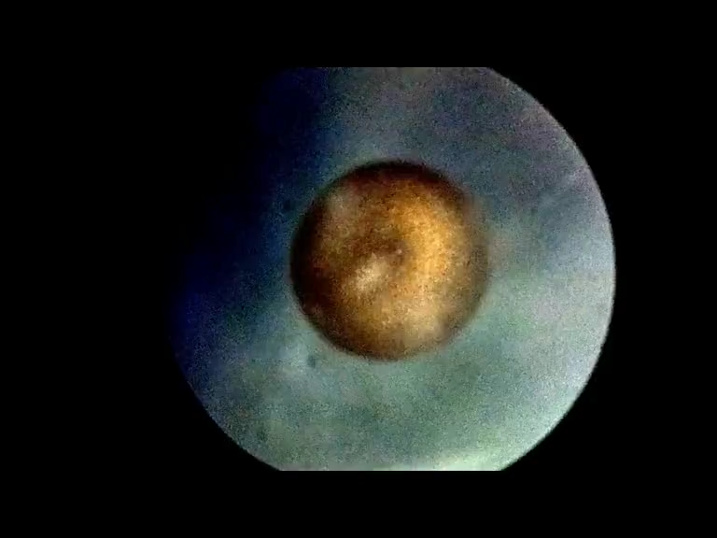
Time lapse embryonic development of an axolotl
Source: Brandon Antonio Segura Torres & Priscilla Vieto Bonilla, 2025

Slide 4
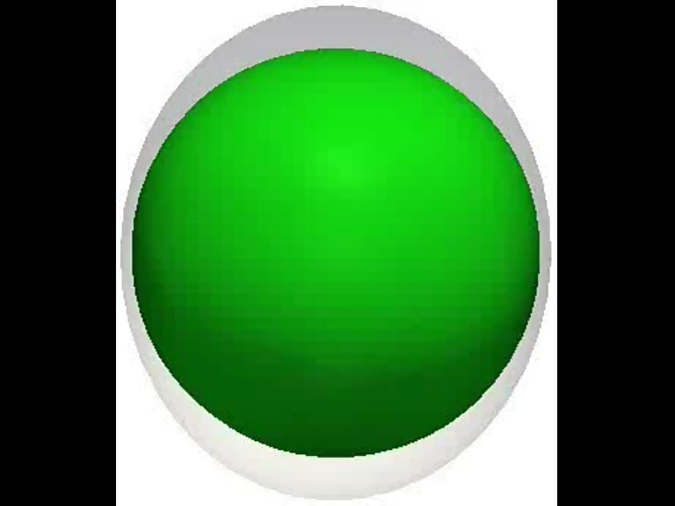
Embryonic development model
Source: Krupinski P, Chickarmane V, Peterson C, PLOS Computational Biology, 2011

Slide 5
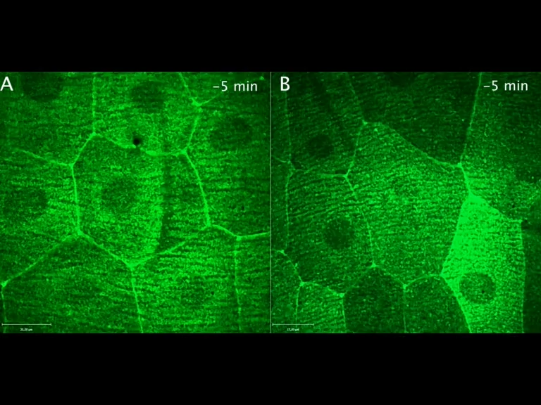
Wound healing
Source: Kakanj P et al, Nature Communications, 2016

Slide 6
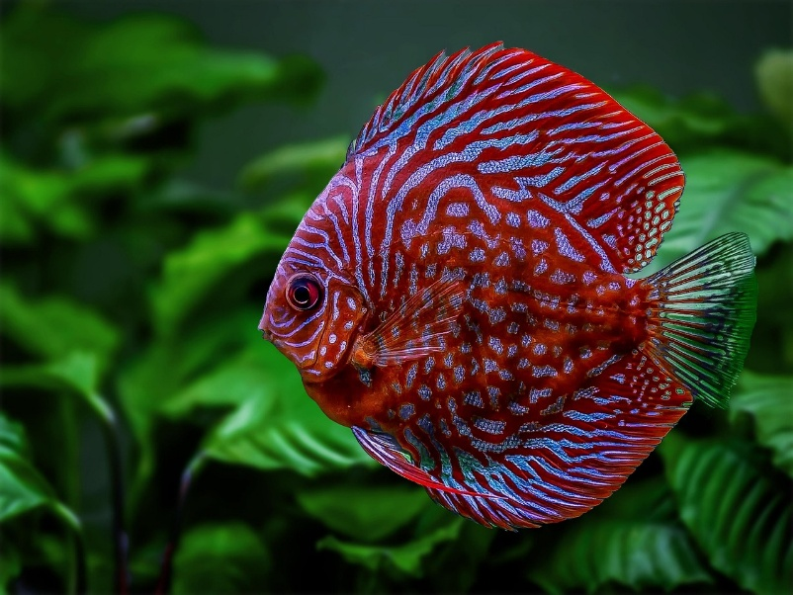
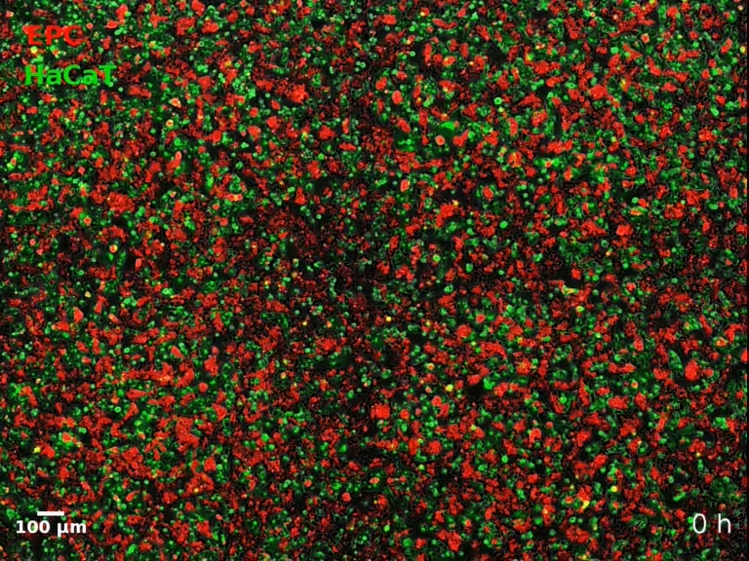
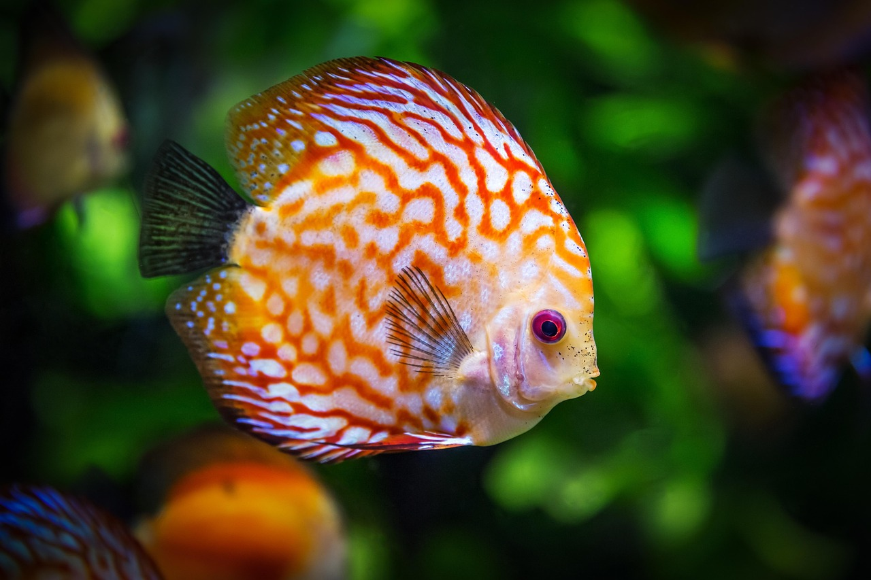
Pattern formation
https://pixabay.com/photos/search/diskus%20ciklider/
Source: Méhes E, Mones E, Németh V, Vicsek T, PLOS ONE, 2012
https://pixabay.com/photos/search/diskus%20ciklider/

Slide 7
Table of contents
DF model and dynamics
DF cell representation
Shape preserving forces
Interaction forces
Resulting dynamics
Validation of hard DF model
Comparison of Monte Carlo simulations
Analysis of DF dynamics
Diffusion behaviour
Shape deformation analysis

Slide 8
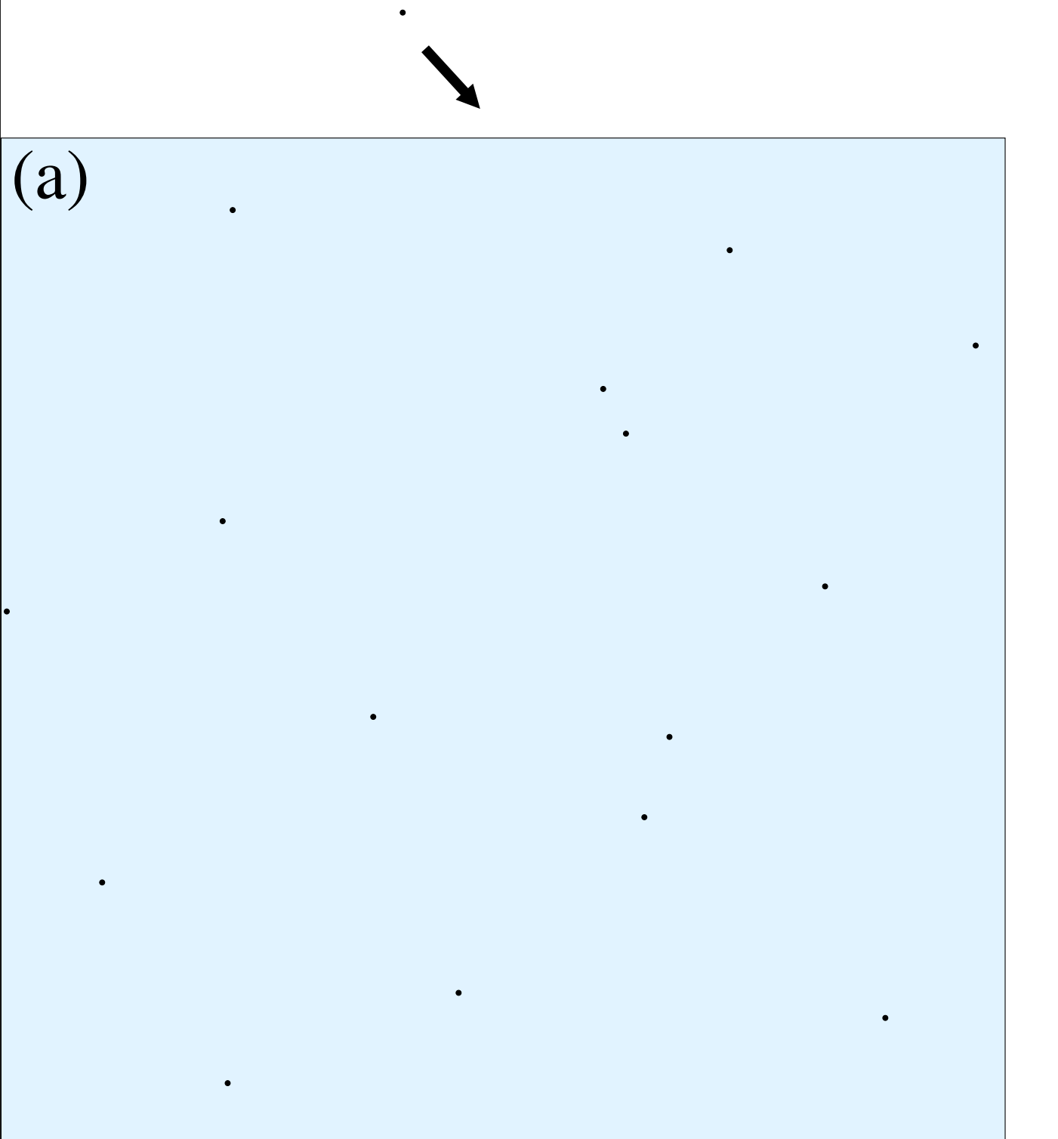
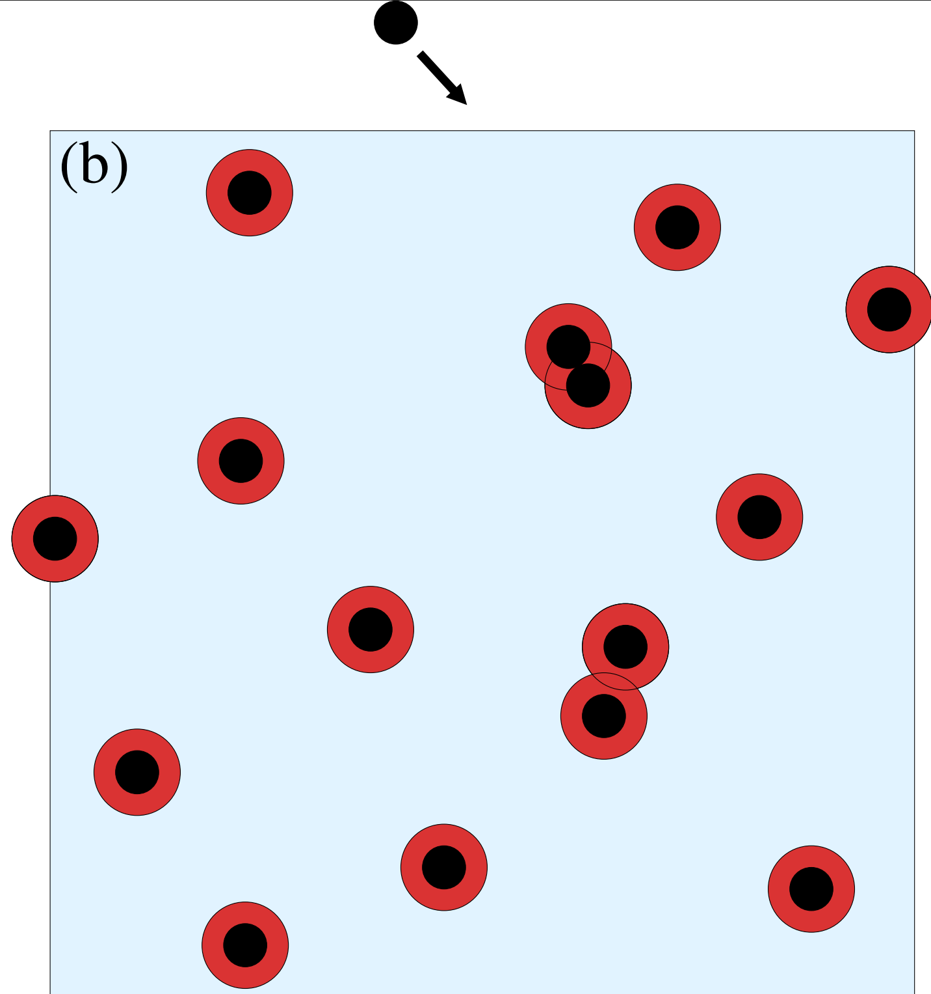
1. DF model and dynamics
Point particles and spherical models
Simplest approach
No interaction or shape modelling
Models spherical cells
Adds soft or hard interaction
No shape deformation

Slide 9
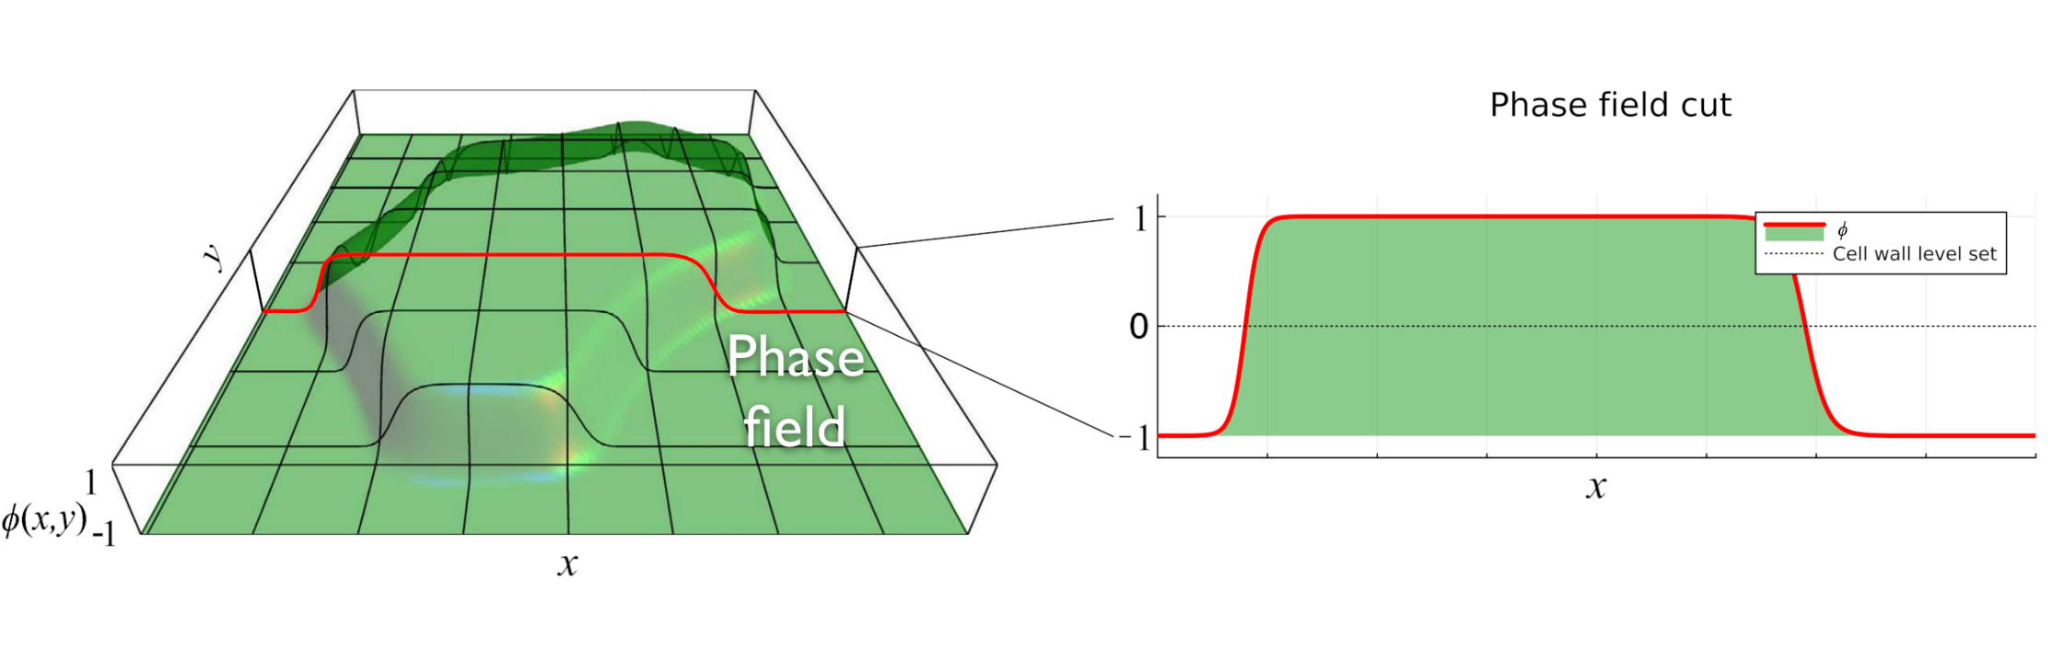

1. DF model and dynamics
Phase field model
Cells are continuous functions $φ:ℝ^{2}→\left[−1,1\right]$
All kind of cell shapes can be represented continuously
Easy computation of overlaps between two cells

Slide 10
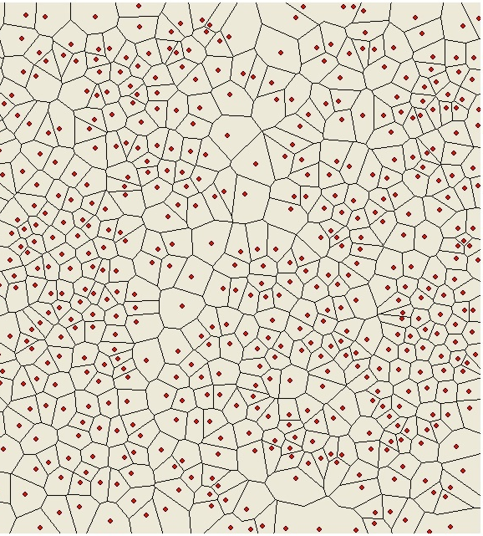
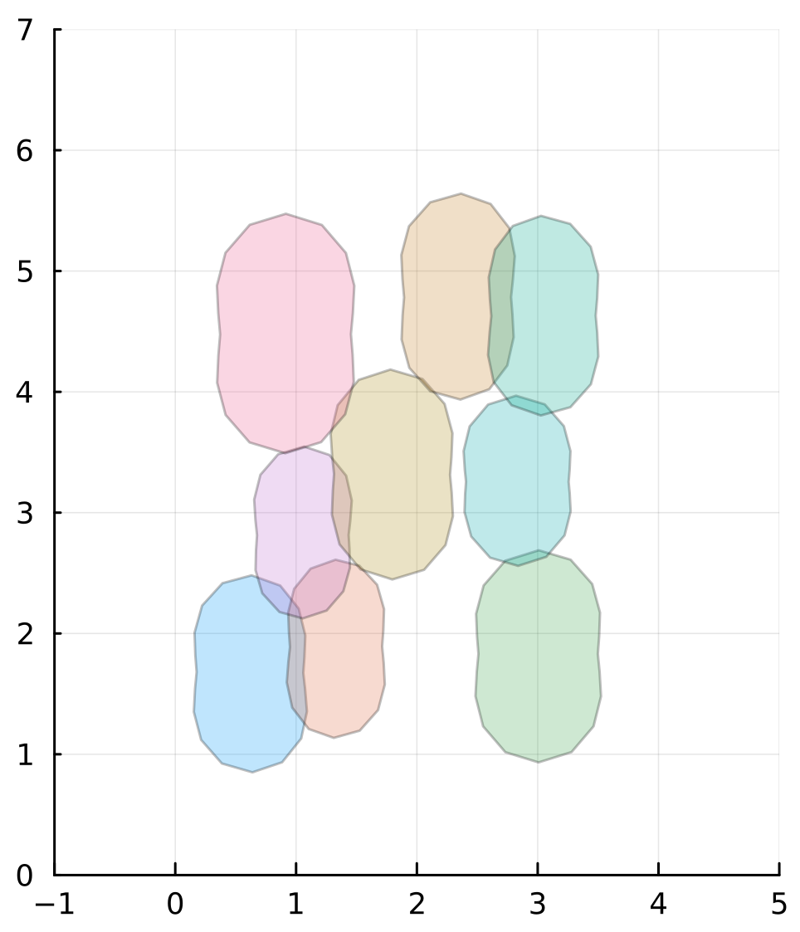
1. DF model and dynamics
Vertex based models
https://commons.wikimedia.org/wiki/File:Voronoi_on_neurons.jpg
confluent
non-confluent

Slide 11
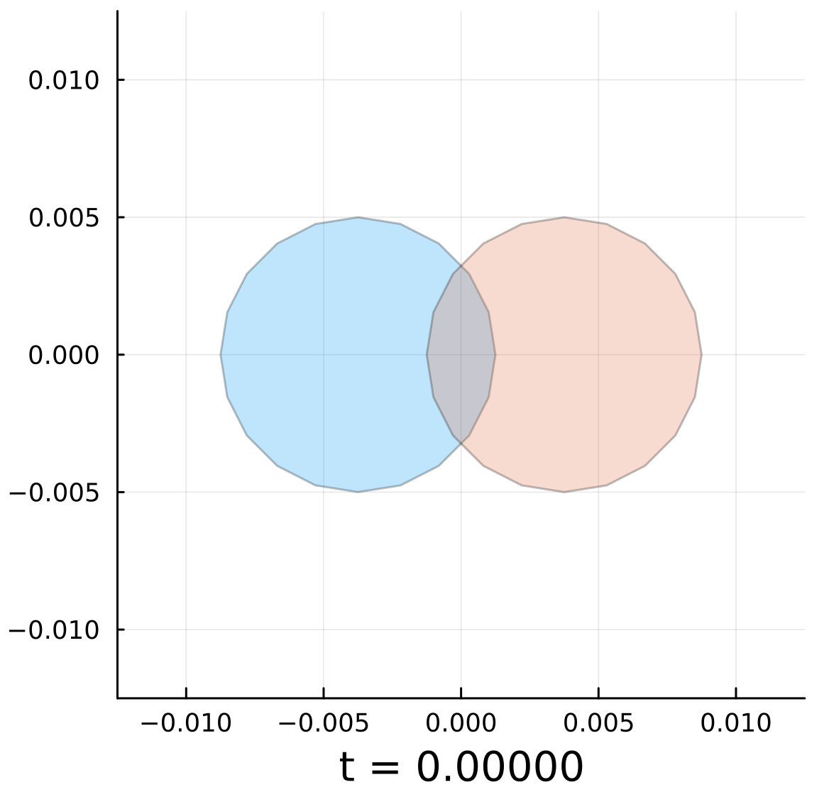
1. DF model and dynamics
DF cell
We want to model:
Shape deformation
Cells should move in a non-confluent dynamic allowing space between the cells

Slide 12
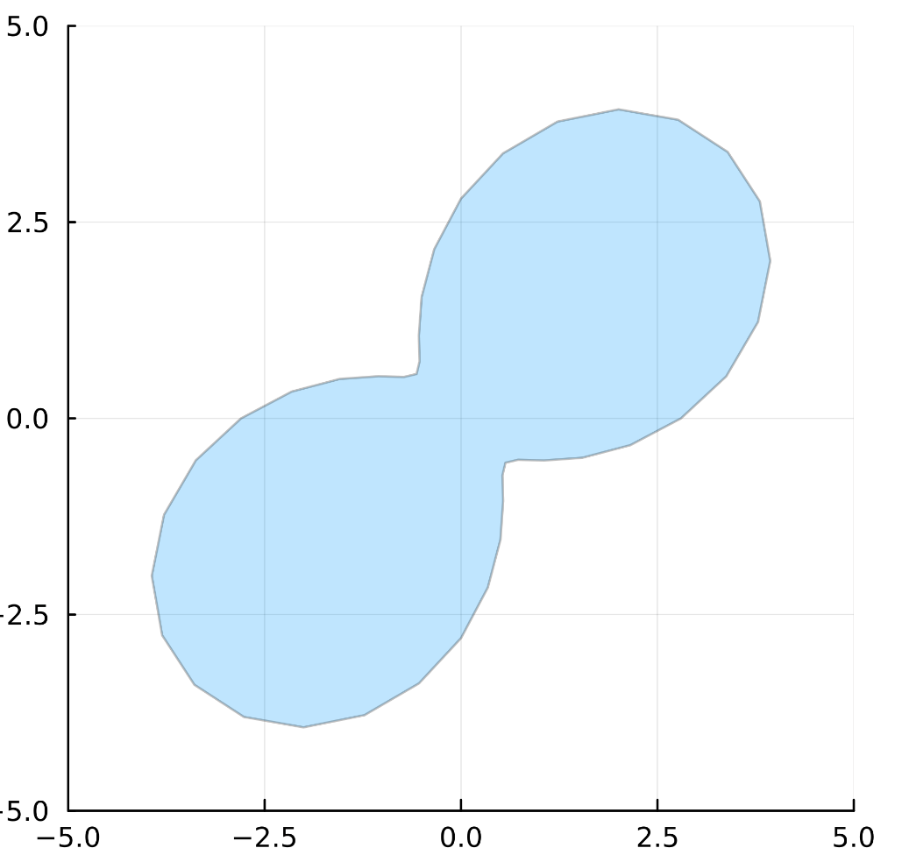
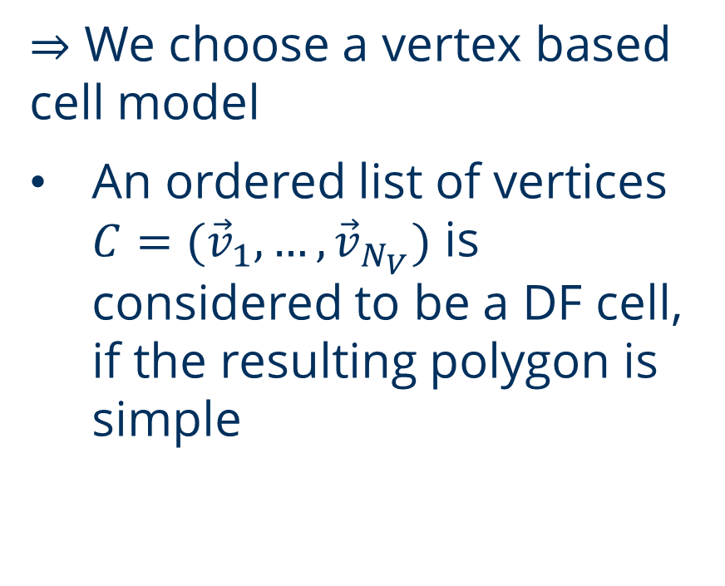
1. DF model and dynamics
DF cell
$⇒$ We choose a vertex based cell model
An ordered list of vertices $C=({\vec{v}}_{1},…,{\vec{v}}_{N_{V}})$ is considered to be a DF cell, if the resulting polygon is simple

Slide 13
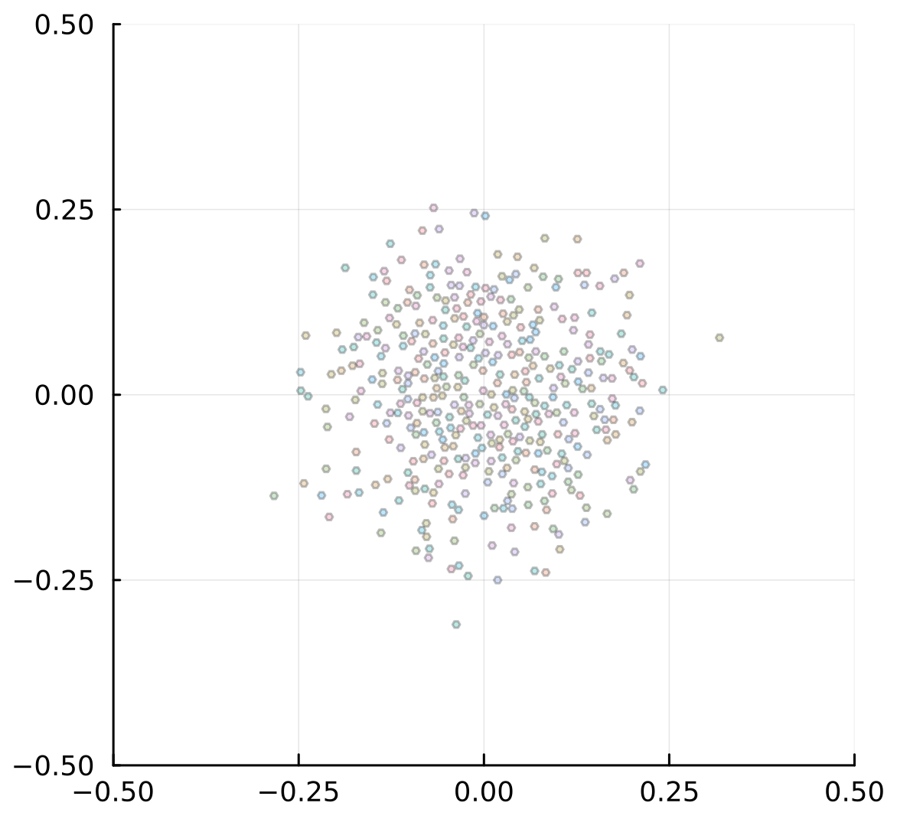
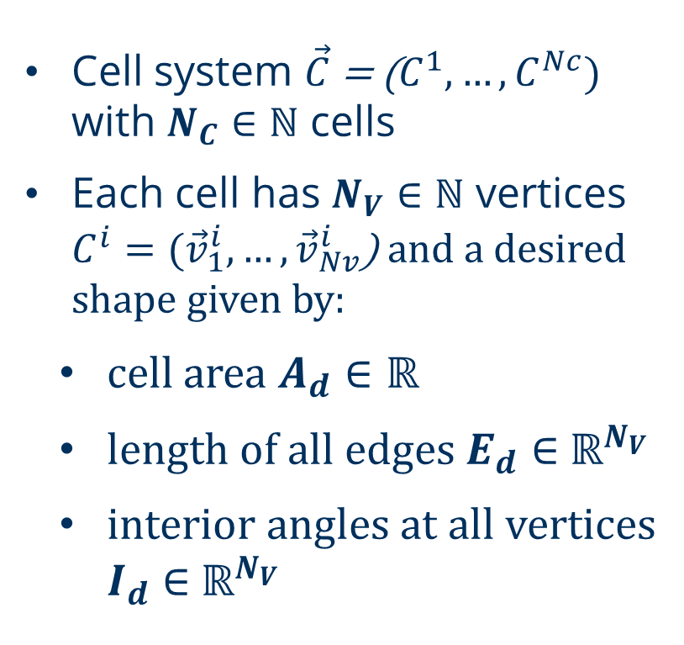
1. DF model and dynamics
DF simulation
Cell system $\vec{C}$ = ($C_{ }^{1},…,C_{ }^{Nc})$ with $N_{C}∈ℕ$ cells
Each cell has $N_{V}∈ℕ$ vertices $C^{i}=({\vec{v}}_{1}^{i},…,{\vec{v}}_{Nv}^{i}$) and a desired shape given by:
cell area $A_{d}∈ℝ$
length of all edges $E_{d}∈$ $ℝ^{N_{V}}$
interior angles at all vertices $I_{d}∈$ $ℝ^{N_{V}}$

Slide 14
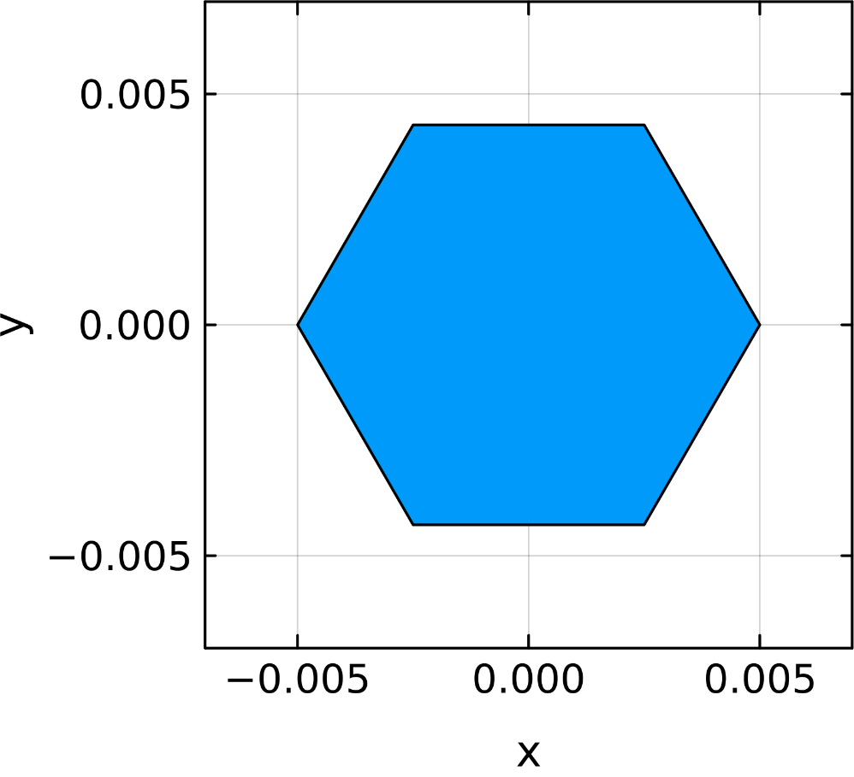
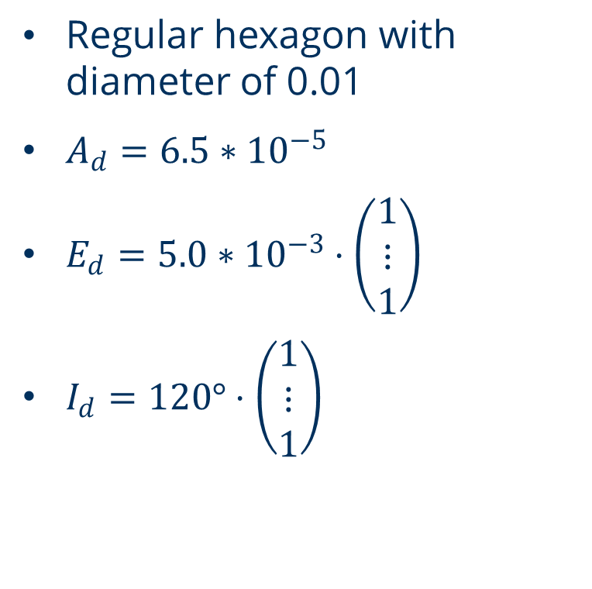
1. DF model and dynamics
Our desired state
Regular hexagon with diameter of 0.01
$A_{d}=6.5∗{10}^{−5}$
$E_{d}=5.0∗{10}^{−3}⋅\left(\begin{matrix}1 \\ ⋮ \\ 1\end{matrix}\right)$
$I_{d}=120°⋅\left(\begin{matrix}1 \\ ⋮ \\ 1\end{matrix}\right)$

Slide 15
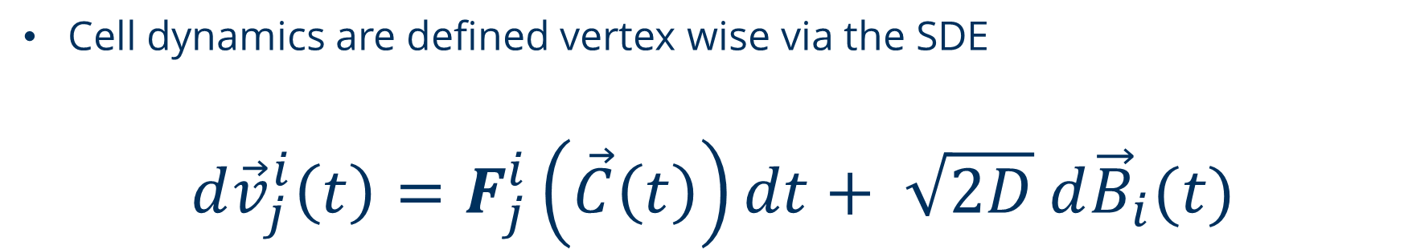
1. DF model and dynamics
DF SDE
Cell dynamics are defined vertex wise via the SDE
$$d{\vec{v}}_{j}^{i}\left(t\right)=F_{j}^{i}\left(\vec{C}\left(t\right)\right)dt+ \sqrt{2D} d{\vec{B}}_{i}(t)$$
Deterministic part
Brownian motion

Slide 16
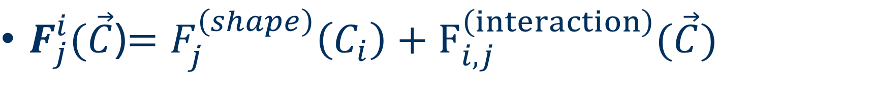
1. DF model and dynamics
Deterministic part
$F_{j}^{i}(\vec{C}$)$=F_{j}^{\left(shape\right)}\left(C_{i}\right)+F_{i,j}^{\left(interaction\right)}(\vec{C})$
Conservation of cell shape by maintaining cell area, edge lengths and interior angles
Resolvation of cell overlaps with shape deformations and transport of cells

Slide 17
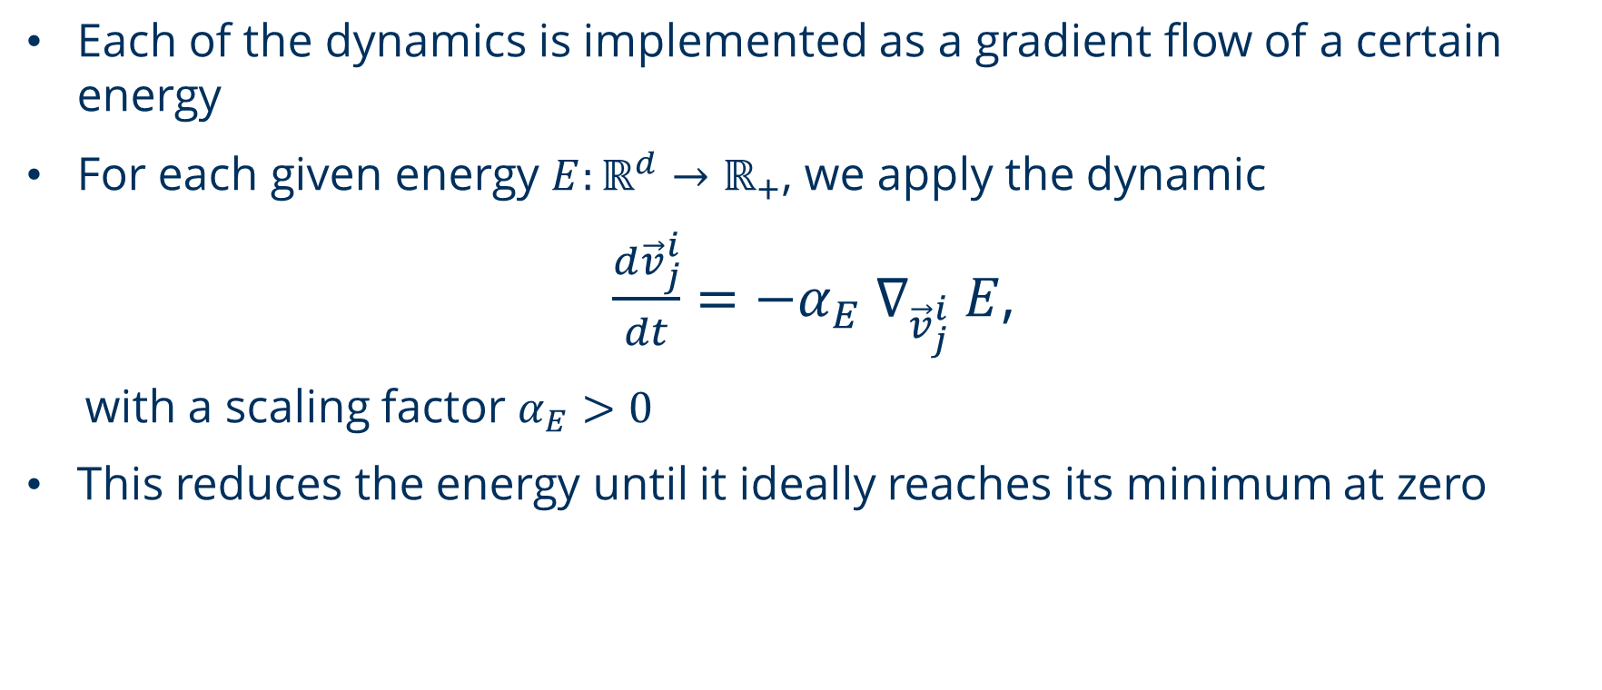
1. DF model and dynamics
Deterministic part
Each of the dynamics is implemented as a gradient flow of a certain energy
For each given energy $E:ℝ^{d}→ℝ_{+}$, we apply the dynamic
$\frac{d{\vec{v}}_{j}^{i}}{dt}=−α_{E} ∇_{{\vec{v}}_{j}^{i}} E$,
with a scaling factor $α_{E}>0$
This reduces the energy until it ideally reaches its minimum at zero

Slide 18
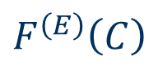
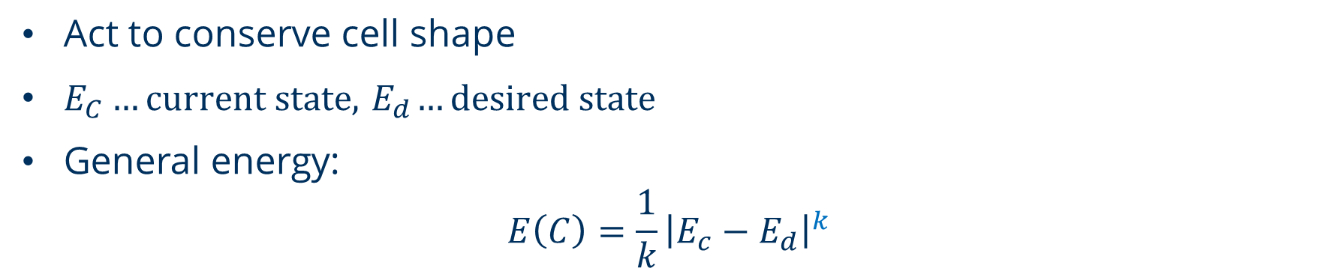
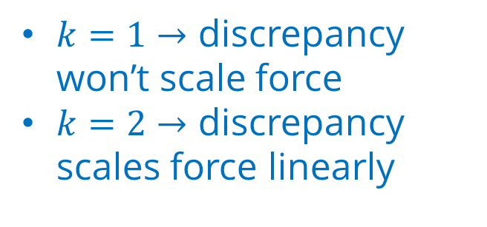
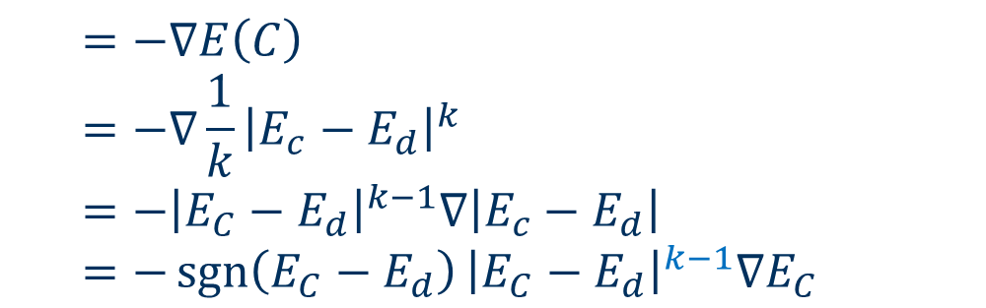
1. DF model and dynamics
Shape preserving forces
Act to conserve cell shape
$E_{C}…current state, { E}_{d}…desired state$
General energy:
$$E\left(C\right)=\frac{1}{k}{\left|E_{c}−E_{d}\right|}^{k}$$
Power of the discrepancy between current and desired state
General force:
$$F^{\left(E\right)}\left(C\right)$$
$$=−∇E\left(C\right)$$
$$=−∇\frac{1}{k}{\left|E_{c}−E_{d}\right|}^{k}$$
$$=−{\left|E_{C}−E_{d}\right|}^{k−1}∇\left|E_{c}−E_{d}\right|$$
$$=−{\operatorname{sgn}\left(E_{C}−E_{d}\right)\left|E_{C}−E_{d}\right|}^{k−1}∇E_{C}$$
$k=1→$ discrepancy won’t scale force
$k=2→$ discrepancy scales force linearly

Slide 19
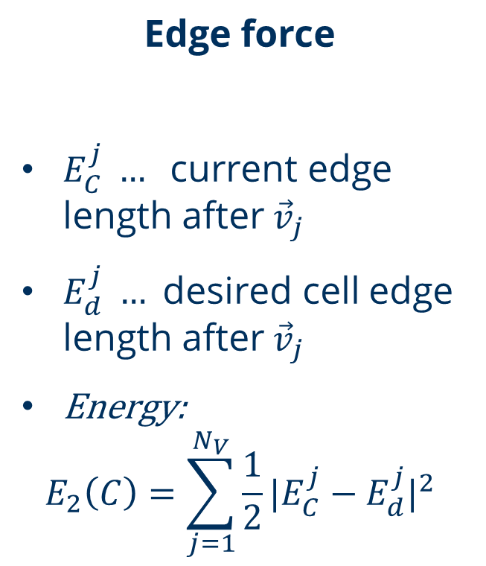
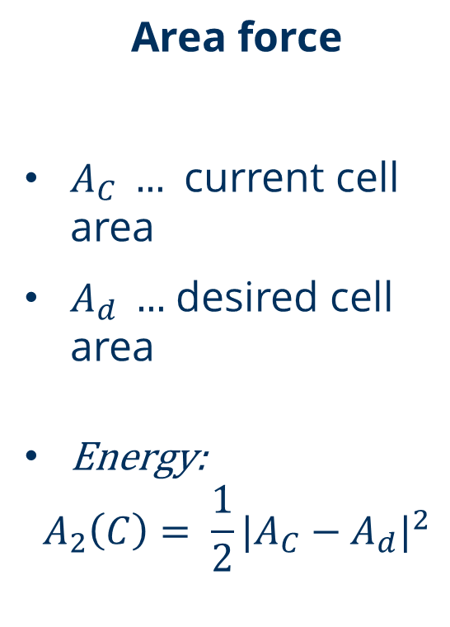
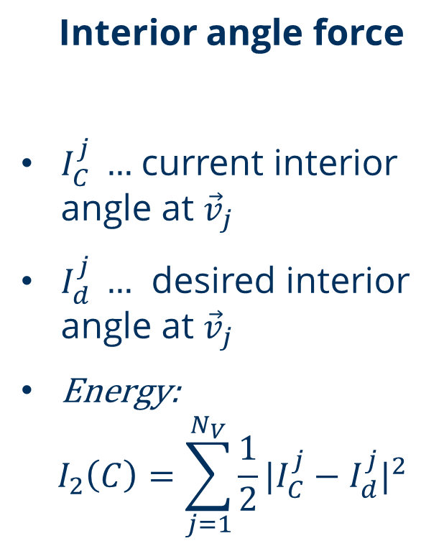
1. DF model and dynamics
Shape preserving forces
Area force
$A_{C} …$ current cell area
$A_{d} …$ desired cell area
Energy:
$$A_{2}\left(C\right)= \frac{1}{2}|A_{C}−A_{d}|^{2}$$
Edge force
$E_{C}^{j} … \text{current}$ edge length after${\vec{v}}_{j}$
$E_{d}^{j} … \text{desired} \text{cell}$ edge length after${\vec{v}}_{j}$
$\text{Energy}\text{:}$
$$E_{2}\left(C\right)=\sum_{j=1}^{N_{V}}{\frac{1}{2}}|E_{C}^{j}−E_{d}^{j}|^{2}$$
Interior angle force
$I_{C}^{j} …$ current interior angle at ${\vec{v}}_{j}$
$I_{d}^{j} …$ desired interior angle at ${\vec{v}}_{j}$
$\text{Energy}\text{:}$
$$I_{2}\left(C\right)=\sum_{j=1}^{N_{V}}{\frac{1}{2}}|I_{C}^{j}−I_{d}^{j}|^{2}$$

Slide 20
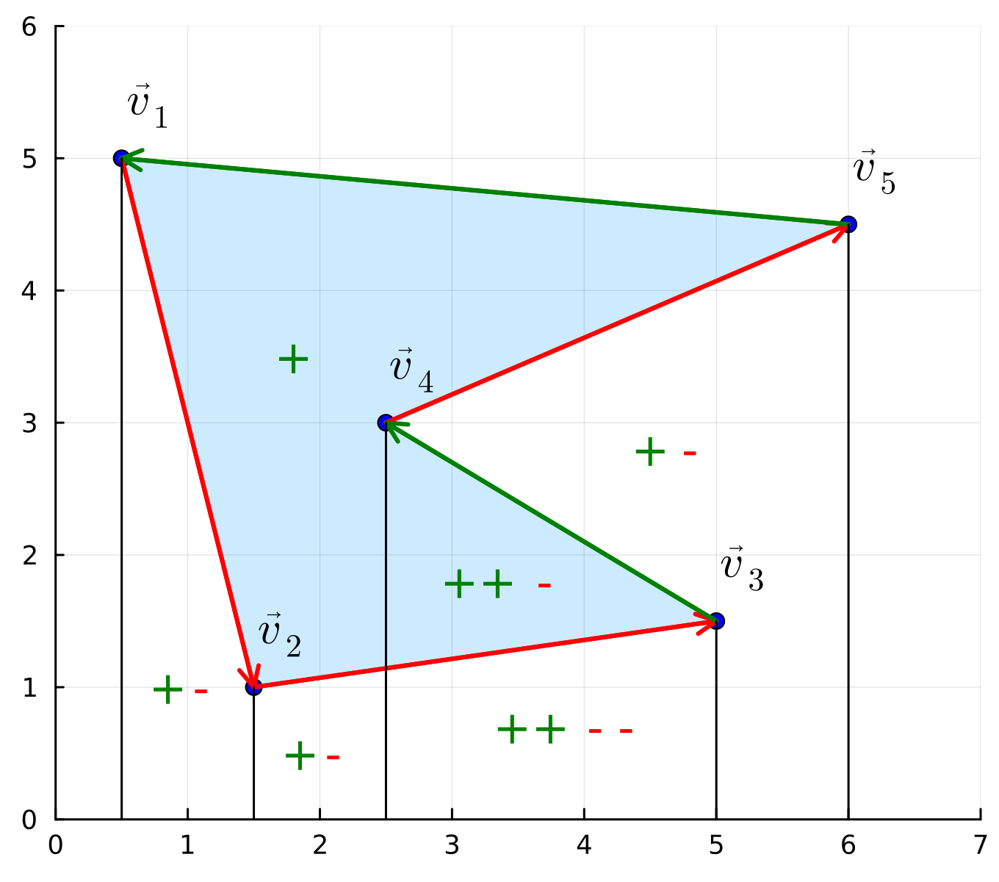
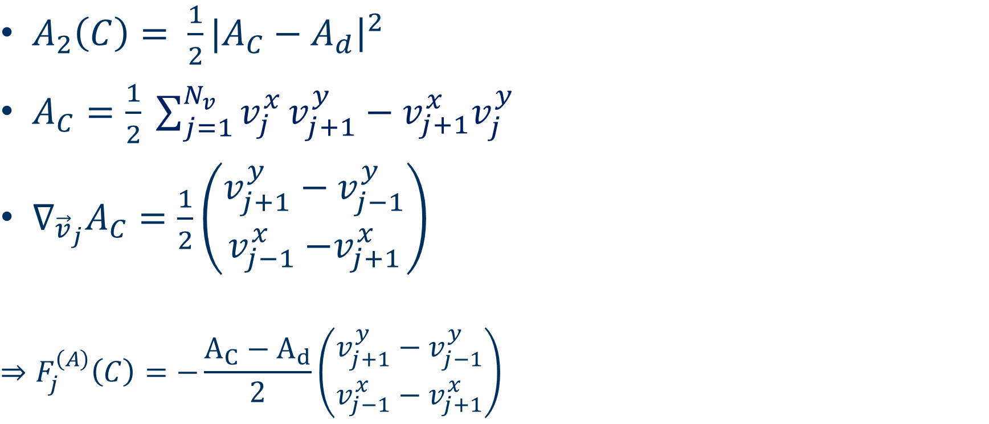
1. DF model and dynamics
Area energy
$A_{2}\left(C\right)= \frac{1}{2}|A_{C}−A_{d}{\left.​\right|}^{2}$
$A_{C}=\frac{1}{2} \sum_{j=1}^{N_{v}}{v_{j}^{x}}v_{j+1}^{y}−v_{j+1}^{x}v_{j}^{y}$
$∇_{{\vec{v}}_{j}}A_{C}=\frac{1}{2}\left(\begin{matrix}v_{j+1}^{y}−v_{j−1}^{y} \\ v_{j−1}^{x}{−v}_{j+1}^{x}\end{matrix}\right)$
$$⇒F_{j}^{\left(A\right)}\left(C\right)=−\frac{{A_{C}−A}_{d}}{2}\left(\begin{matrix}v_{j+1}^{y}−v_{j−1}^{y} \\ v_{j−1}^{x}−v_{j+1}^{x}\end{matrix}\right)$$
Shoelace Formula

Slide 21
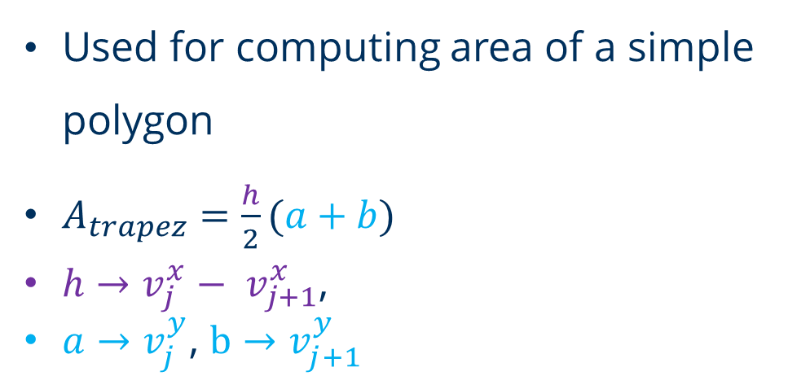

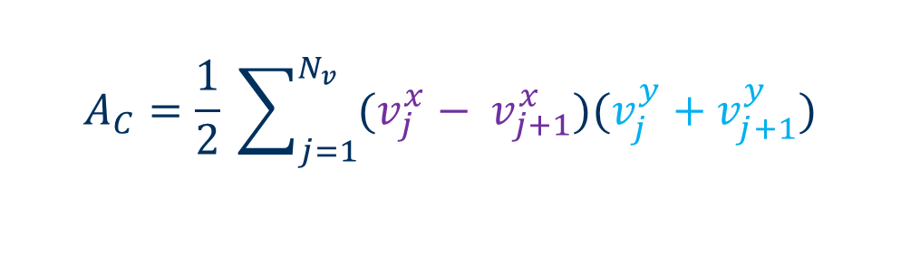
1. DF model and dynamics
Shoelace formula
Used for computing area of a simple polygon
$A_{trapez}=\frac{h}{2}(a+b)$
$h→v_{j}^{x}− v_{j+1}^{x}$,
$a→v_{j}^{y}$, $b→v_{j+1}^{y}$
$$A_{C}=\frac{1}{2} \sum_{j=1}^{N_{v}}{(v_{j}^{x}− v_{j+1}^{x})(v_{j}^{y}+v_{j+1}^{y}})$$
$$=\frac{1}{2} \sum_{j=1}^{N_{v}}{v_{j}^{x}}v_{j+1}^{y}−v_{j+1}^{x}v_{j}^{y}$$

Slide 22
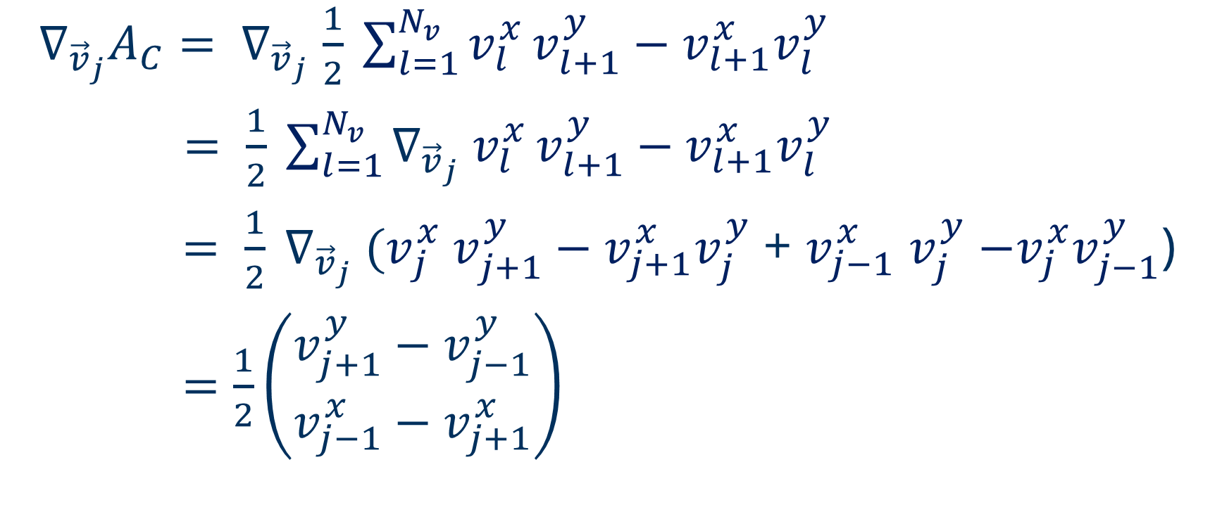
1. DF model and dynamics
Area force
$∇_{{\vec{v}}_{j}}A_{C}= ∇_{{\vec{v}}_{j}}$ $\frac{1}{2} \sum_{l=1}^{N_{v}}{v_{l}^{x}}v_{l+1}^{y}−v_{l+1}^{x}v_{l}^{y}$
$= \frac{1}{2} \sum_{l=1}^{N_{v}}{∇_{{\vec{v}}_{j}} v_{l}^{x}}v_{l+1}^{y}−v_{l+1}^{x}v_{l}^{y}$
$= \frac{1}{2} {{∇_{{\vec{v}}_{j}} (v}_{j}^{x} v}_{j+1}^{y}−v_{j+1}^{x}v_{j}^{y}$ + $v_{j−1}^{x}$ $v_{j}^{y}$ $−v_{j}^{x}v_{j−1}^{y}$)
$=\frac{1}{2}\left(\begin{matrix}v_{j+1}^{y}−v_{j−1}^{y} \\ v_{j−1}^{x}−v_{j+1}^{x}\end{matrix}\right)$

Slide 23
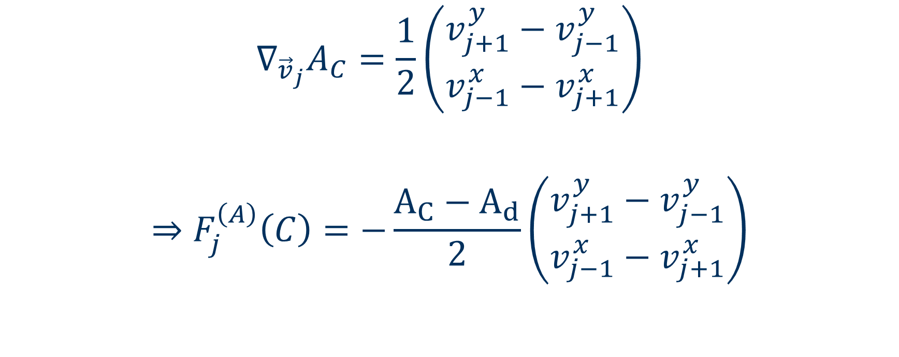
1. DF model and dynamics
Area force
$$∇_{{\vec{v}}_{j}}A_{C}=\frac{1}{2}\left(\begin{matrix}v_{j+1}^{y}−v_{j−1}^{y} \\ v_{j−1}^{x}−v_{j+1}^{x}\end{matrix}\right)$$
$$⇒F_{j}^{\left(A\right)}\left(C\right)=−\frac{{A_{C}−A}_{d}}{2}\left(\begin{matrix}v_{j+1}^{y}−v_{j−1}^{y} \\ v_{j−1}^{x}−v_{j+1}^{x}\end{matrix}\right)$$

Slide 24
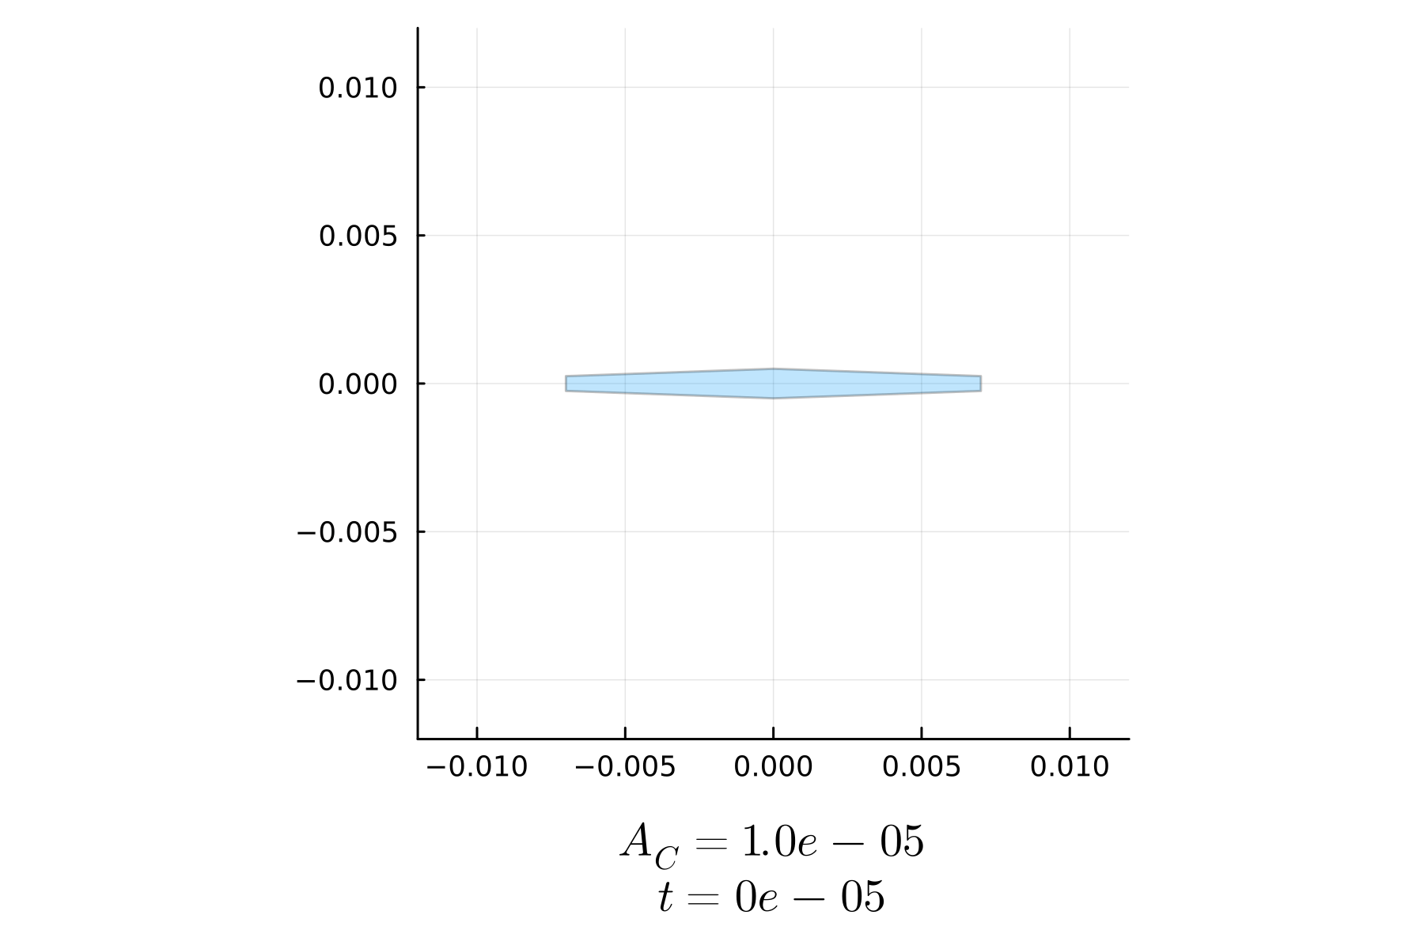
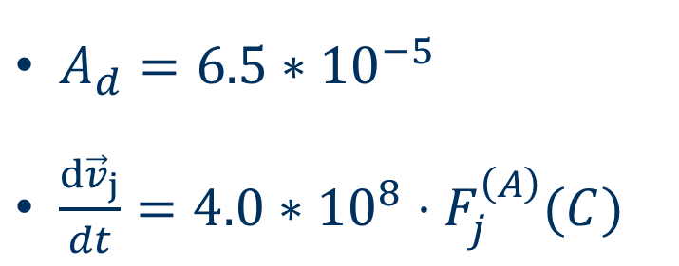
1. DF model and dynamics
Application of area force
$A_{d}=6.5∗{10}^{−5}$
$\frac{d{\vec{v}}_{j}}{dt}=4.0∗{10}^{8}⋅F_{j}^{\left(A\right)}(C)$

Slide 25
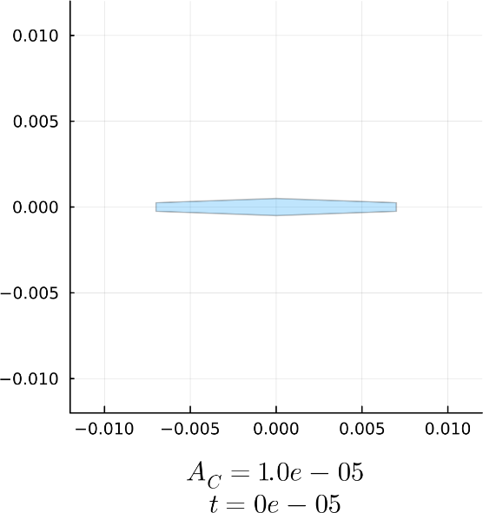
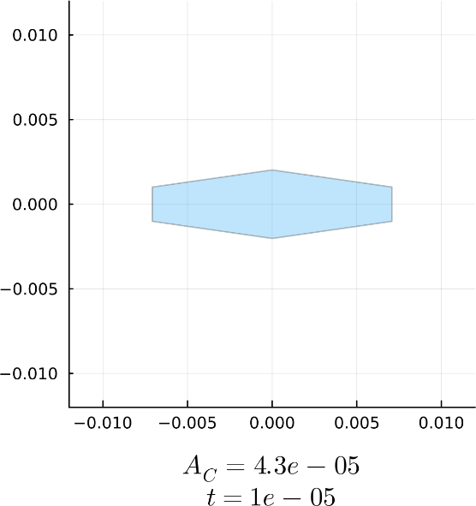
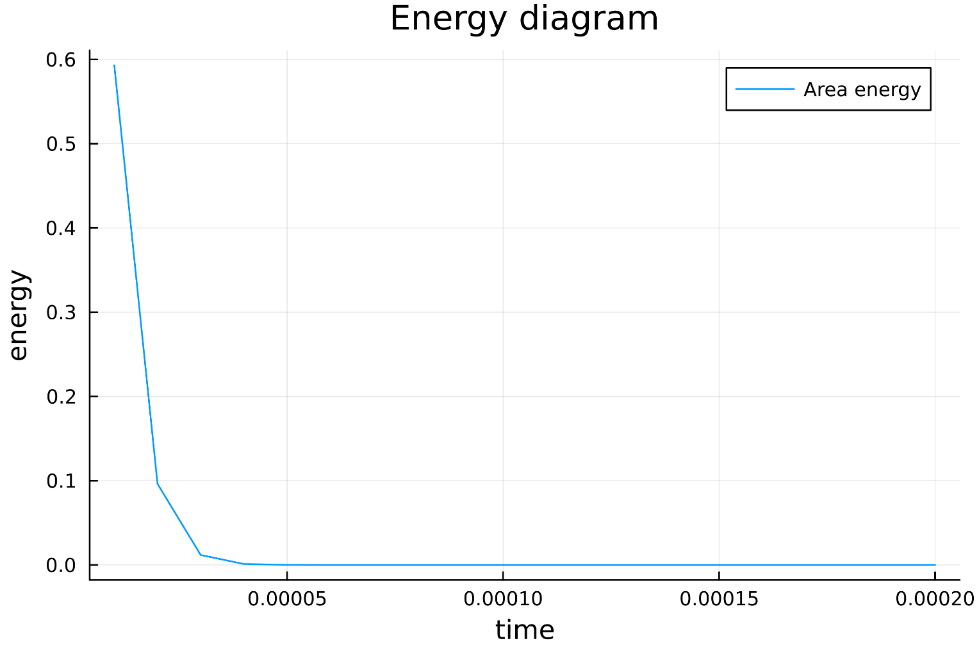

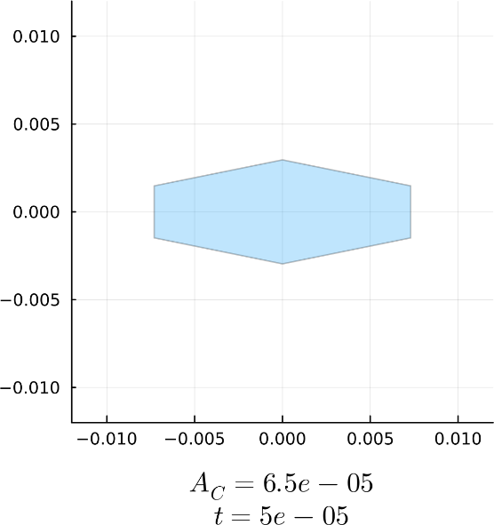
1. DF model and dynamics
Application of area force

Slide 26
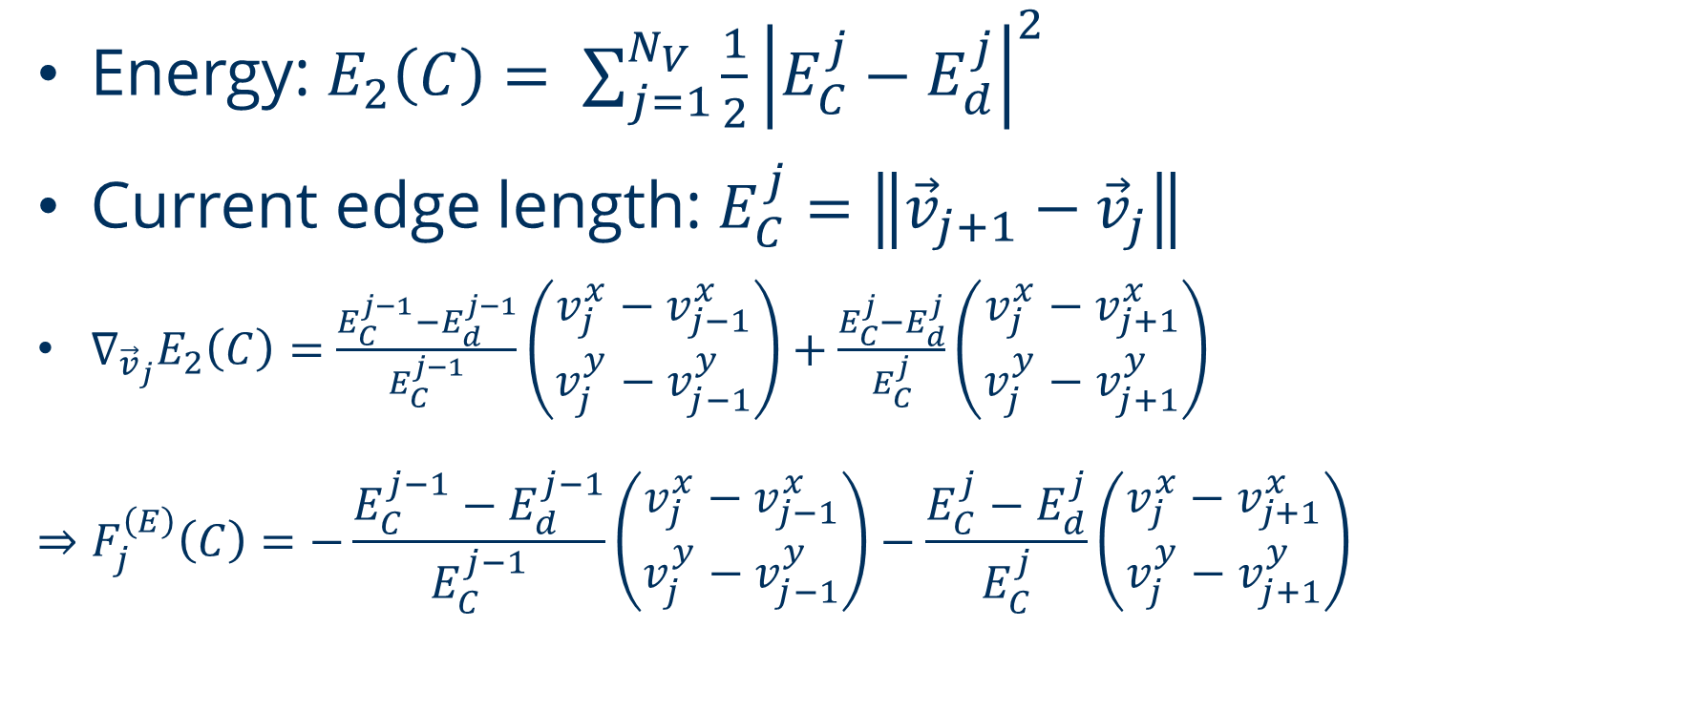
1. DF model and dynamics
Edge energy
Energy: $E_{2}\left(C\right)= {\sum_{j=1}^{N_{V}}{\frac{1}{2}\left|E_{C}^{j}−E_{d}^{j}\right|}}^{2}$
Current edge length: $E_{C}^{j}=\left\|{\vec{v}}_{j+1}−{\vec{v}}_{j}\right\|$
$∇_{{\vec{v}}_{j}}E_{2}\left(C\right)=$ $\frac{E_{C}^{j−1}−E_{d}^{j−1}}{E_{C}^{j−1}}\left(\begin{matrix}v_{j}^{x}−v_{j−1}^{x} \\ v_{j}^{y}−v_{j−1}^{y}\end{matrix}\right)+\frac{E_{C}^{j}−E_{d}^{j}}{E_{C}^{j}}\left(\begin{matrix}v_{j}^{x}−v_{j+1}^{x} \\ v_{j}^{y}−v_{j+1}^{y}\end{matrix}\right)$
$$⇒F_{j}^{\left(E\right)}\left(C\right)=−\frac{E_{C}^{j−1}−E_{d}^{j−1}}{E_{C}^{j−1}}\left(\begin{matrix}v_{j}^{x}−v_{j−1}^{x} \\ v_{j}^{y}−v_{j−1}^{y}\end{matrix}\right)−\frac{E_{C}^{j}−E_{d}^{j}}{E_{C}^{j}}\left(\begin{matrix}v_{j}^{x}−v_{j+1}^{x} \\ v_{j}^{y}−v_{j+1}^{y}\end{matrix}\right)$$

Slide 27
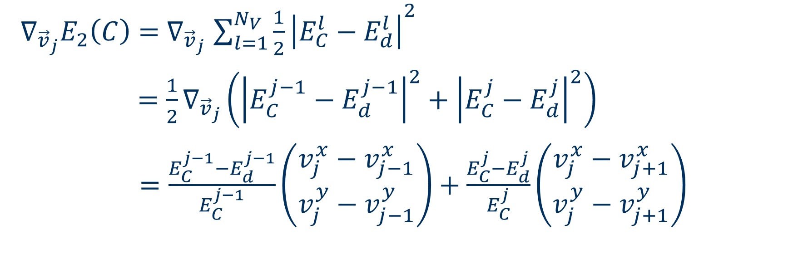
1. DF model and dynamics
Edge force
$∇_{{\vec{v}}_{j}}E_{2}\left(C\right)=$ $∇_{{\vec{v}}_{j}}$ ${\sum_{l=1}^{N_{V}}{\frac{1}{2}\left|E_{C}^{l}−E_{d}^{l}\right|}}^{2}$
$=\frac{1}{2}∇_{{\vec{v}}_{j}}\left({\left|E_{C}^{j−1}−E_{d}^{j−1}\right|}^{2}+{\left|E_{C}^{j}−E_{d}^{j}\right|}^{2}\right)$
$=\frac{E_{C}^{j−1}−E_{d}^{j−1}}{E_{C}^{j−1}}\left(\begin{matrix}v_{j}^{x}−v_{j−1}^{x} \\ v_{j}^{y}−v_{j−1}^{y}\end{matrix}\right)+\frac{E_{C}^{j}−E_{d}^{j}}{E_{C}^{j}}\left(\begin{matrix}v_{j}^{x}−v_{j+1}^{x} \\ v_{j}^{y}−v_{j+1}^{y}\end{matrix}\right)$

Slide 28
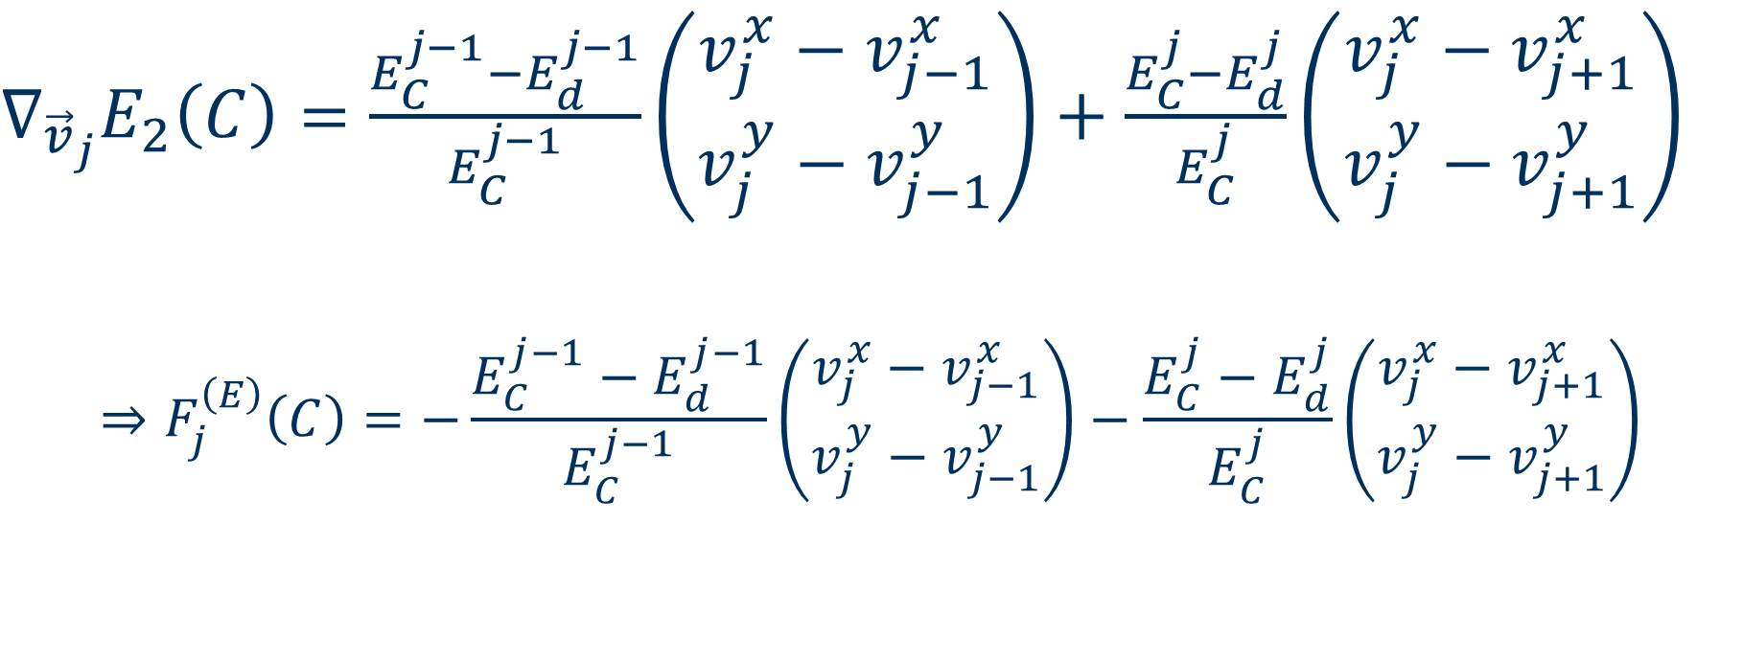
1. DF model and dynamics
Edge force
$∇_{{\vec{v}}_{j}}E_{2}\left(C\right)=$ $\frac{E_{C}^{j−1}−E_{d}^{j−1}}{E_{C}^{j−1}}\left(\begin{matrix}v_{j}^{x}−v_{j−1}^{x} \\ v_{j}^{y}−v_{j−1}^{y}\end{matrix}\right)+\frac{E_{C}^{j}−E_{d}^{j}}{E_{C}^{j}}\left(\begin{matrix}v_{j}^{x}−v_{j+1}^{x} \\ v_{j}^{y}−v_{j+1}^{y}\end{matrix}\right)$
$$⇒F_{j}^{\left(E\right)}\left(C\right)=−\frac{E_{C}^{j−1}−E_{d}^{j−1}}{E_{C}^{j−1}}\left(\begin{matrix}v_{j}^{x}−v_{j−1}^{x} \\ v_{j}^{y}−v_{j−1}^{y}\end{matrix}\right)−\frac{E_{C}^{j}−E_{d}^{j}}{E_{C}^{j}}\left(\begin{matrix}v_{j}^{x}−v_{j+1}^{x} \\ v_{j}^{y}−v_{j+1}^{y}\end{matrix}\right)$$

Slide 29
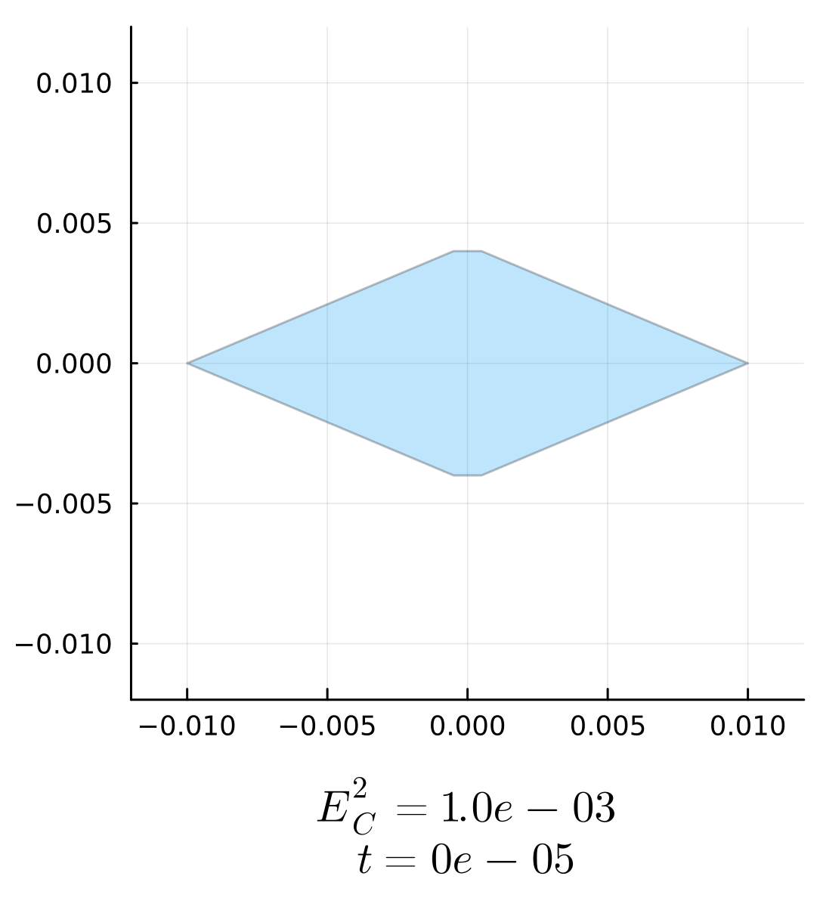
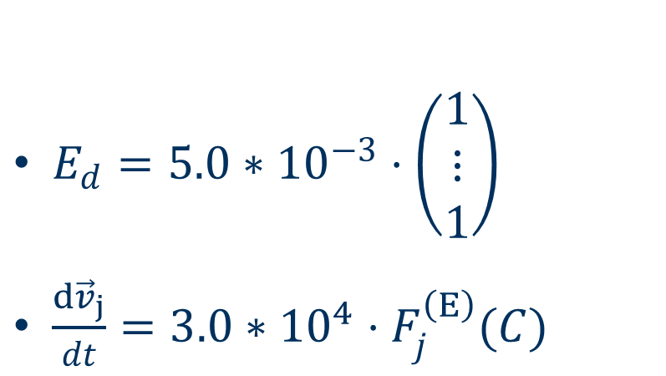
1. DF model and dynamics
Application of edge force
$E_{d}=5.0∗{10}^{−3}⋅\left(\begin{matrix}1 \\ ⋮ \\ 1\end{matrix}\right)$
$\frac{d{\vec{v}}_{j}}{dt}=3.0∗{10}^{4}⋅F_{j}^{\left(E\right)}(C)$

Slide 30
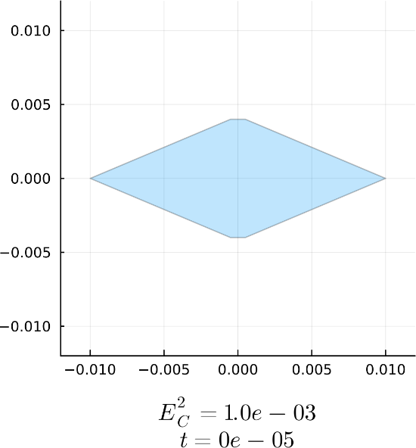
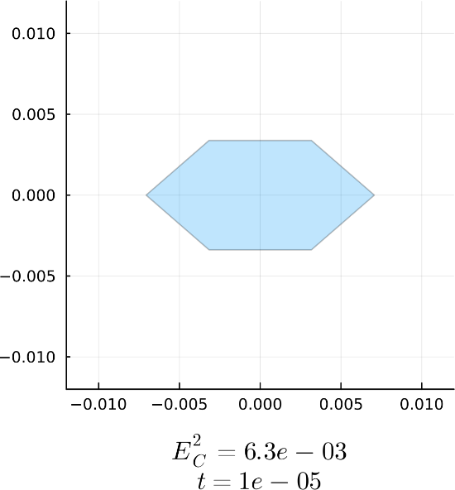
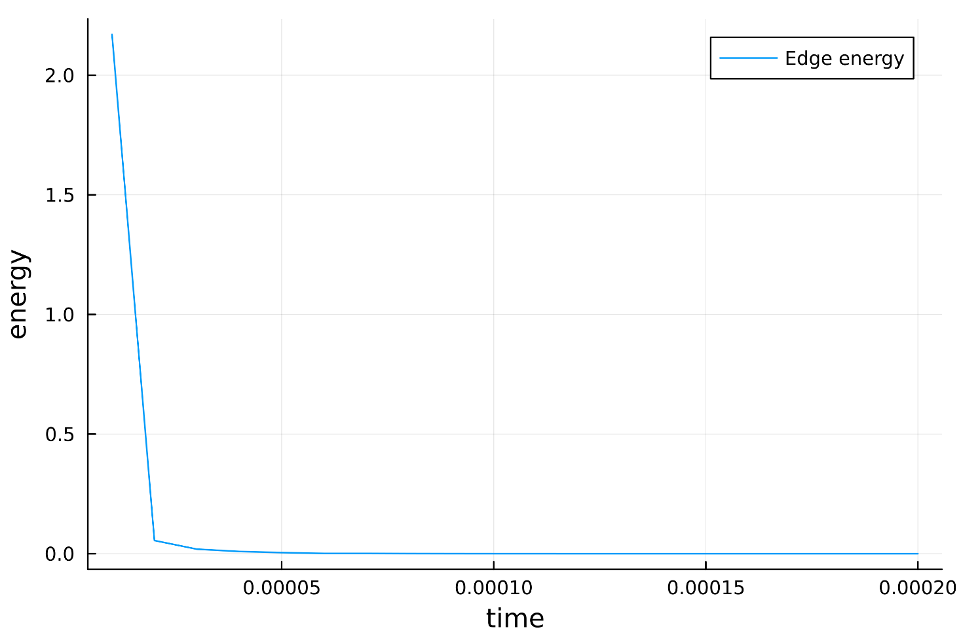
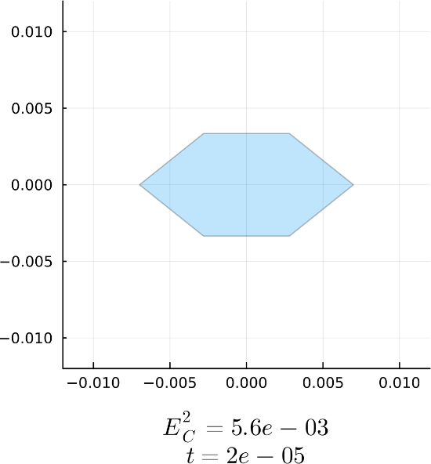
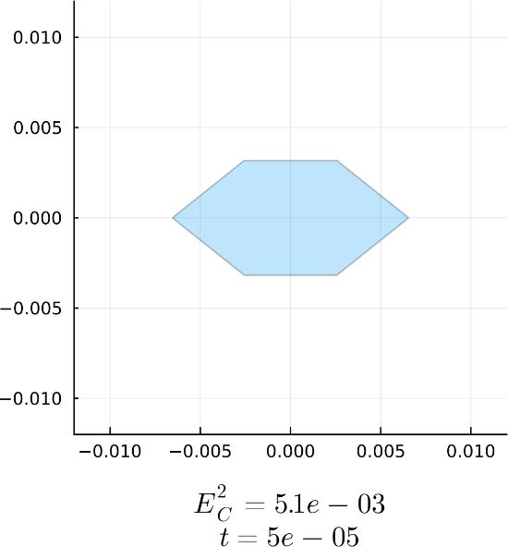
1. DF model and dynamics
Application of edge force

Slide 31

1. DF model and dynamics
Interior angle energy
Energy: $I_{2}\left(C\right)= {\sum_{j=1}^{N_{V}}{\frac{1}{2}\left|I_{C}^{j}−I_{d}^{j}\right|}}^{2}$
How compute interior angles?

Slide 32


1. DF model and dynamics
Computation of current interior angles
For $\vec{v}={\left(v^{x}, v^{y}\right)}^{T}$, arctan2$:ℝ^{2}/\{0\}→(−π,π]$ is defined by
It returns the angle between the given vector and the $x$-axis

Slide 33

1. DF model and dynamics
Computation of current interior angles
arctan2($\vec{v}$) returns the angle between $\vec{v}$ and the $x$-axis
$⇒θ_{1}=arctan2\left({\vec{v}}_{j−1}−{\vec{v}}_{j}\right)…$ angle between ${\vec{v}}_{j−1}−{\vec{v}}_{j}$ w and $x$-axis
$θ_{2}=arctan2\left({\vec{v}}_{j+1}−{\vec{v}}_{j}\right)…$ angle between ${\vec{v}}_{j+1}−{\vec{v}}_{j}$ w w and $x$-axis
$⇒{I_{C}^{j}=\left[θ_{1}−θ_{2}\right]}_{\left(0, 2π\right)}$ angle at ${\vec{v}}_{j}$
${\vec{v}}_{j}$ influences the interior angles at ${\vec{v}}_{j−1,}$ ${\vec{v}}_{j}$ and ${\vec{v}}_{j+1}$

Slide 34

1. DF model and dynamics
Interior angle gradient
$∇_{{\vec{v}}_{j}}I_{2}\left(C\right)=$ $∇_{{\vec{v}}_{j}}$ ${\sum_{l=1}^{N_{V}}{\frac{1}{2}\left|I_{C}^{l}−I_{d}^{l}\right|}}^{2}$
$$=\frac{1}{2}∇_{{\vec{v}}_{j}}\left({\left|I_{C}^{j−1}−I_{d}^{j−1}\right|}^{2}+{\left|I_{C}^{j}−I_{d}^{j}\right|}^{2}+{\left|I_{C}^{j+1}−I_{d}^{j+1}\right|}^{2}\right)$$

Slide 35


1. DF model and dynamics
Interior angle force
$∇_{{\vec{v}}_{j}}I_{2}\left(C\right)= \left(I_{C}^{j−1}−I_{d}^{j−1}\right)\left(−\frac{1}{{\left\|{\vec{v}}_{j}−{\vec{v}}_{j+1}\right\|}^{2}}\left(\begin{matrix}v_{j−1}^{y}−v_{j}^{y} \\ v_{j}^{x}−v_{j−1}^{x}\end{matrix}\right)\right)$
$$+\left(I_{C}^{j}−I_{d}^{j}\right)\left(\frac{1}{{\left\|{\vec{v}}_{j}−{\vec{v}}_{j−1}\right\|}^{2}}\left(\begin{matrix}v_{j−1}^{y}−v_{j}^{y} \\ v_{j}^{x}−v_{j−1}^{x}\end{matrix}\right)−\frac{1}{{\left\|{\vec{v}}_{j}−{\vec{v}}_{j+1}\right\|}^{2}}\left(\begin{matrix}v_{j+1}^{y}−v_{j}^{y} \\ v_{j}^{x}−v_{j+1}^{x}\end{matrix}\right)\right)$$
$$+\left(I_{C}^{j+1}−I_{d}^{j+1}\right)\left(\frac{1}{{\left\|{\vec{v}}_{j}−{\vec{v}}_{j+1}\right\|}^{2}}\left(\begin{matrix}v_{j+1}^{y}−v_{j}^{y} \\ v_{j}^{x}−v_{j+1}^{x}\end{matrix}\right)\right)$$
$⇒F_{j}^{\left(I\right)}\left(C\right)=$ ${−∇}_{{\vec{v}}_{j}}I_{2}\left(C\right)$

Slide 36


1. DF model and dynamics
Application of interior angle force
$I_{d}=\frac{2}{3}π⋅\left(\begin{matrix}1 \\ ⋮ \\ 1\end{matrix}\right)$
$\frac{d{\vec{v}}_{j}}{dt}=0.1⋅F_{j}^{\left(I\right)}(C)$

Slide 37





1. DF model and dynamics
Application of interior angle force

Slide 38

1. DF model and dynamics
Interaction energies
Cells interact to dissolve cell overlaps
Two approaches: transport cells, deform cells
$E:ℝ^{2N_{V}N_{C}}→ℝ_{+}$, $\vec{C}↦E\left(\vec{C}\right)…$interaction energy
$F_{i, j}^{(E)}\left(\vec{C}\right)…$interaction force of energy E that acts on vertex $j$ of cell $i$

Slide 39

1. DF model and dynamics
Bounce overlap dynamic
Only works for disc-like cells
We use the cell centre $\vec{x}=\frac{1}{N_{V}}\sum_{j=1}^{N_{V}}{{\vec{v}}_{j}}$ and assume a cell radius of $r>0$
Goal: whenever two cell centres are closer than $2r$, transport them away from each other
Imitates reflections of hard sphere models

Slide 40

1. DF model and dynamics
Bounce overlap energy
$$\overline{O}:ℝ^{2N_{V}N_{C}} →ℝ_{+}, \overline{O}\left(\vec{C}\right)=\frac{1}{N_{C}}\sum_{i=1}^{N_{C}}{\sum_{j>i}^{N_{C}}{(ψ∘χ)(C_{i}−C_{j})}}$$
$χ:ℝ^{2N_{V}}→ℝ_{+},$ $χ\left(C_{i}−C_{j}\right)= \left\|{\vec{x}}_{i}−{\vec{x}}_{j}\right\|$
$ψ:ℝ_{+}→ℝ_{+},$ $ψ\left(d\right)=\frac{N_{V}}{2}1_{\left[0,2r\right)}\left(d\right){\left(2r−d\right)}^{2}$

Slide 41

1. DF model and dynamics
Bounce overlap force
$$F_{i,j}^{(\overline{O})}:ℝ^{2N_{V}N_{C}} →ℝ^{2}$$
$$\vec{C}↦F_{i,j}^{\left(\overline{O}\right)}\left(\vec{C}\right)=−∇_{{\vec{v}}_{j}^{i}} \overline{O}(\vec{C})$$
$$=−\frac{1}{N_{C}}\sum_{l≠i}{1_{\left[0,2r\right)}}\left(\left\|{\vec{x}}_{i}−{\vec{x}}_{l}\right\|\right)\left(\left\|{\vec{x}}_{i}−{\vec{x}}_{l}\right\|−2r\right)\frac{{\vec{x}}_{i}−{\vec{x}}_{l}}{\left\|{\vec{x}}_{i}−{\vec{x}}_{l}\right\|}$$

Slide 42


1. DF model and dynamics
Application of bounce overlap force
$\frac{d{\vec{v}}_{j}^{i}}{dt}=2.0∗{10}^{5}⋅F_{i,j}^{(\overline{O})}(\vec{C})$

Slide 43





1. DF model and dynamics
Application of bounce overlap force

Slide 44
1. DF model and dynamics
Deforming overlap dynamic
Works for all cell shapes
Whenever two cells overlap, all overlap involved vertices move to shrink the overlap
Identification of these overlaps and involved vertices uses a complex algorithm
Imitates cells squeezing when applying pressure

Slide 45



1. DF model and dynamics
Deforming overlap energy
$Ω_{C_{i}, C_{j}}…$set of all overlaps between $C_{i}$ and $C_{j}$
${\hat{O}}_{k}:ℝ^{2N_{V}N_{C}}→ℝ_{+}$,
$$\vec{C}↦{\hat{O}}_{k}\left(\vec{C}\right)= \sum_{i=1}^{N_{C}}{\sum_{j>i}^{N_{C}}{\sum_{D∈Ω_{C_{i}, C_{j}}}{{\frac{1}{k}A}_{D}^{ k}}}}$$
$F_{i,j}^{\left(\hat{O}\right)}\left(\vec{C}\right)=−∇_{{\vec{v}}_{j}^{i}}{\hat{O}}_{1}(\vec{C})$

Slide 46


1. DF model and dynamics
Deforming overlap dynamic
$Ω_{C_{1},C_{2}}=\{D\}$
$D=\left({\vec{v}}_{1}^{1},{\vec{w}}_{1},{\vec{v}}_{3}^{2},{\vec{v}}_{4}^{2},{\vec{w}}_{2}\right)$
$W\left(D\right)=\{{\vec{w}}_{1},{\vec{w}}_{2}\}$
$V\left(D\right)=\{{\vec{v}}_{1}^{1},{\vec{v}}_{3}^{2},{\vec{v}}_{4}^{2}\}$
$adj\left({\vec{w}}_{1}\right)=\{{\vec{v}}_{1}^{1},{\vec{v}}_{2}^{1},{\vec{v}}_{2}^{2},{\vec{v}}_{3}^{2}\}$
$in\left({\vec{w}}_{1}\right)=\{{\vec{v}}_{1}^{1},{\vec{v}}_{3}^{2}\}$
$out\left({\vec{w}}_{1}\right)=\{{\vec{v}}_{2}^{1},{\vec{v}}_{2}^{2}\}$

Slide 47


1. DF model and dynamics
Deforming overlap force
$$F_{i,j}^{(\hat{O})}:ℝ^{2N_{V}N_{C}} →ℝ^{2}$$
$$\vec{C}↦F_{i,j}^{\left(\hat{O}\right)}\left(\vec{C}\right)=−∇_{{\vec{v}}_{j}^{i}}{\hat{O}}_{1}(\vec{C})$$
$$=−\sum_{m≠i}^{N_{C}}{\sum_{D∈Ω_{C_{i}, C_{m}}}{A_{D}\{1_{V(D)}\left({\vec{v}}_{j}^{i}\right)∇_{{\vec{v}}_{j}^{i}}A_{D}}+}$$
$$+\sum_{\vec{w}∈W(D)}{(1_{out\left(\vec{w}\right)}\left({\vec{v}}_{j}^{i}\right)D_{{\vec{v}}_{j}^{i}}\vec{w}+1_{in\left(\vec{w}\right)}\left({\vec{v}}_{j}^{i}\right)D_{{\vec{v}}_{j}^{i}}\vec{w})∇_{\vec{w}}A_{D}\}}$$

Slide 48


1. DF model and dynamics
Application of deforming overlap force
$\frac{d{\vec{v}}_{j}^{i}}{dt}=6.0∗{10}^{4}⋅F_{i,j}^{\left(\hat{O}\right)}(\vec{C})$

Slide 49





1. DF model and dynamics
Application of deforming overlap force

Slide 50

1. DF model and dynamics
The DF SDE
We remember the DF SDE:
$$d{\vec{v}}_{j}^{i}\left(t\right)=F_{j}^{i}\left(\vec{C}\left(t\right)\right)dt+ \sqrt{2D} d{\vec{B}}_{i}(t)$$
Transition parameter: hardness $h∈[0,1]$
$⇒$ scales which interaction force is dominant
Deterministic part:
$$F_{j}^{i}\left(\vec{C}\right)={α_{A}F}_{j}^{\left(A\right)}\left(C_{i}\right)+{α_{E}F}_{j}^{\left(E\right)}\left(C_{i}\right)+{α_{I}F}_{j}^{\left(I\right)}\left(C_{i}\right)$$
$$+hα_{\overline{O}}F_{i,j}^{\left(\overline{O}\right)}(\vec{C})+(h−1){α_{\hat{O}}F}_{i,j}^{\left(\hat{O}\right)}(\vec{C})$$
$$⇒h=1… \text{hard} \text{DF} \text{Model}\text{,} h=\frac{1}{2}… \text{mid} \text{DF} \text{Model}\text{, }h=0… \text{soft} \text{DF} \text{Model}$$

Slide 51


1. DF model and dynamics
Resulting dynamics – hard DF model
$h=1$
$\frac{d{\vec{v}}_{j}^{i}}{dt}=F_{j}^{i}\left(\vec{C}\left(t\right)\right)$
No cell deformation

Slide 52

1. DF model and dynamics
Resulting dynamics – hard DF model

Slide 53


1. DF model and dynamics
Resulting dynamics – mid DF model
$h=0.5$
$\frac{d{\vec{v}}_{j}^{i}}{dt}=F_{j}^{i}\left(\vec{C}\left(t\right)\right)$
Small change of shape gets recovered in four time steps

Slide 54

1. DF model and dynamics
Resulting dynamics – mid DF model

Slide 55


1. DF model and dynamics
Resulting dynamics – soft DF model
$h=0$
$\frac{d{\vec{v}}_{j}^{i}}{dt}=F_{j}^{i}\left(\vec{C}\left(t\right)\right)$
Interplay overlap degeneration $↔$ shape recovery

Slide 56

1. DF model and dynamics
Resulting dynamics – soft DF model

Slide 57


2. Validation of hard DF model
2. Validation of hard DF model
First marginal function
$ρ:ℝ_{+}×Ω→ℝ_{+}$
$ρ(t,\vec{x})$ = probability density of finding a single cell at a given position
Time evolution of soft first marginal

Slide 58
2. Validation of hard DF model
2. Validation of hard DF model
Monte Carlo simulation
we do stochastic DF simulation many times
we remember cell positions at sample times throughout all simulations and consider the average behaviour
Emergence of statistical properties
Goal: numerically approximate first marginal of this system

Slide 59

2. Validation of hard DF model
2. Validation of hard DF model
Heatmap
A spatial density plot showing how often cell centres occupy different regions over many simulation runs at a specific time

Slide 60


2. Validation of hard DF model
Heatmaps from Bruna & Chapman 2012
Initial condition: $N_{2}\left(0, {0.09}^{2}\right)$
$N_{C}=400$ cells on domain $Ω={\left[−\frac{1}{2},\frac{1}{2}\right]}^{2}$
Point particle model with pure Brownian motion and no interaction
Hard sphere model with Brownian motion and cell reflections
All plots are at time $t=0.05$
Point particle model first marginal
Point particle model Monte Carlo heatmap
Hard sphere model first marginal
Hard sphere model Monte Carlo heatmap

Slide 61


2. Validation of hard DF model
Hard sphere model and hard DF model
Hard sphere model from Bruna & Chapman
Hard DF model

Slide 62


3. Analysis of DF dynamics
3. Analysis of DF dynamics
Compare diffusion behaviour of hard, mid and soft DF model
Shape deformation analysis
Hard mean field PDE
Initial condition for all DF models

Slide 63




3. Analysis of DF dynamics
Diffusion behaviour comparison
Hard DF model
Mid DF model
Soft DF model

Slide 64

3. Analysis of DF dynamics
Cross section comparison

Slide 65

3. Analysis of DF dynamics
Shape deformation comparison
Measure for shape deformation: asphericity
Let $C$ be a DF cell
Then we use its perimeter $P_{C}$ and its area $A_{C}$, to compute its asphericity
$$α_{C}=4π\frac{A_{C}}{P_{C}^{ 2}}$$
A circle is the only geometrical figure with the maximum asphericity of $1.0$
For all DF cells, we have $α_{C}∈[0,1)$

Slide 66





3. Analysis of DF dynamics
Shape deformation comparison
$$Area=3.2∗{10}^{−5}$$
$$Perimeter=0.026$$
$Asphericity=0.6$1
$$Area=5.0∗{10}^{−5}$$
$$Perimeter=0.028$$
$Asphericity=$0.79
$Area=$ $6.5∗{10}^{−5}$
$Perimeter=$0.030
$$Asphericity=0.91$$
$$Area=7.9∗{10}^{−5}$$
$$Perimeter=0.031$$
$Asphericity=1$.0

Slide 67

3. Analysis of DF dynamics
Shape deformation comparison

Slide 68


References

Slide 69


References

Slide 70

References

